Slide 1
USDA-NRCS Web Soil Survey access and use soil maps of “your farm” on planning and management of regular farm operations DEMONSTRATION
2011 Fall Potato School
By Lincoln Zotarelli and Steven Lands
Hastings, 22 September 2011

Slide 2
Introduction Web soil survey (WSS)
Web Soil Survey application provides producers, agencies, etc, electronic access to relevant soil and related information needed to make wise land use & management decisions.
The purpose of WSS is to provide alternative to traditional hardcopy publication of maps with interactive access to most current data.
WSS allows customers to get just information they want/select about map units for their geographic area of interest (AOI) and collect information relevant to their land use concerns – e.g. cropland.

Slide 3
How can you use the WSS data and maps to improve your management decisions?
WSS through a set of aerial photographs/address/gps coordinates allows you to find and select areas of interest (AOI) in you own property
After finding AOI, you will be able to exactly select an specific area by drawing a polygon in the map indicating all corners of that AOI. After selected AOI, the WSS will process that AOI and provide you information like:
Actual area in acres of area of interest
Soil map classification
View and print soil maps and soil unit description
Linear measurement
Explore capability of use accordingly to soil series

Slide 4
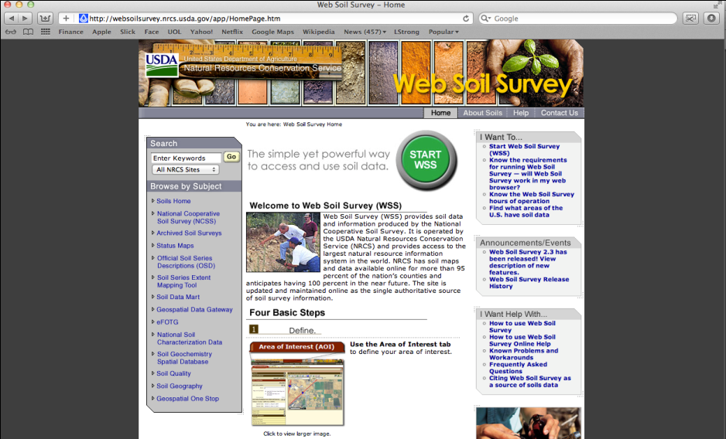
Step 1. Main page - http://websoilsurvey.nrcs.usda.gov/app/HomePage.htm

Slide 5
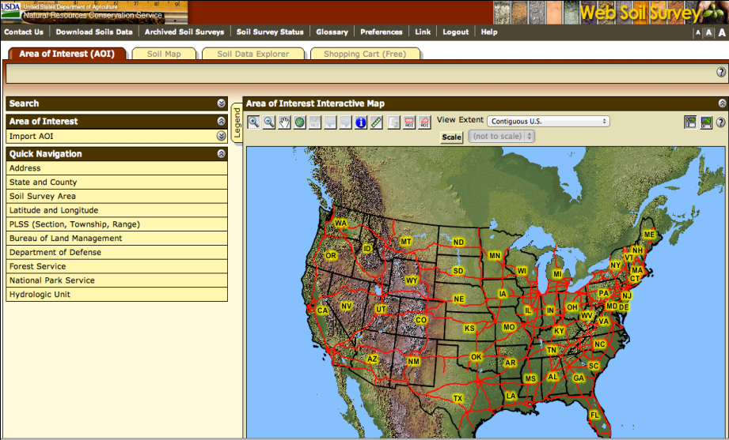
Step 2. WSS Opening Screen

Slide 6
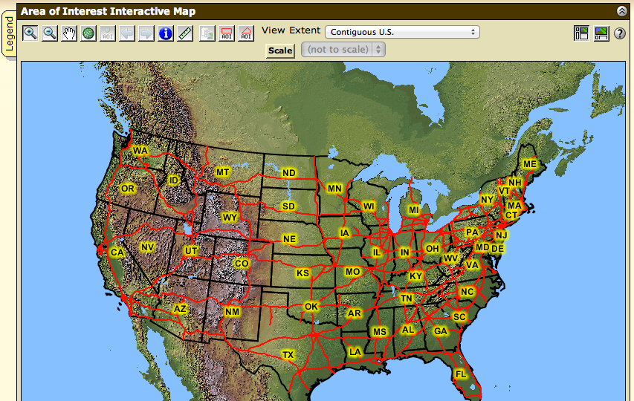
Step 3 - View Map at Full Screen Width

Slide 7
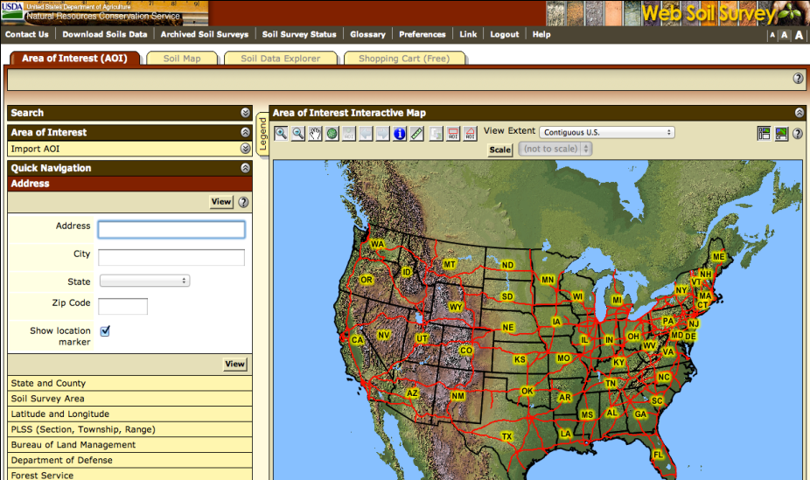
Step 4 – Search Function – (Address, State & County, Latitude and Longitude)

Slide 8
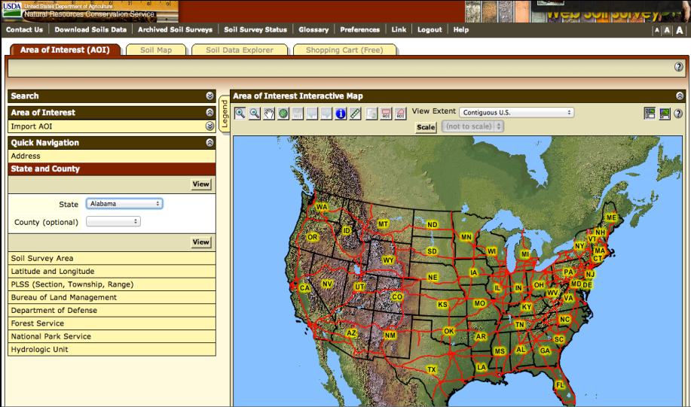
Step 5 – State and County Localization

Slide 9
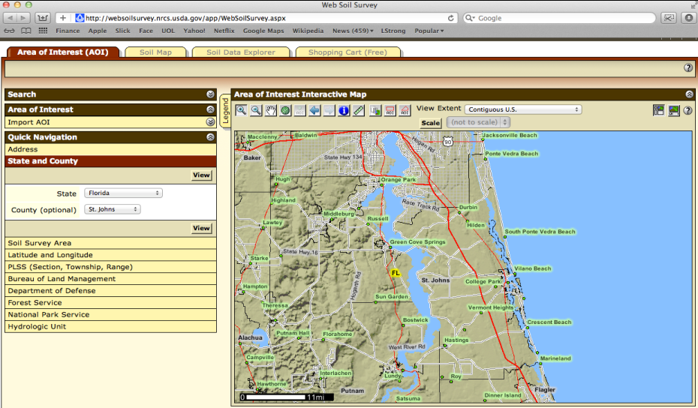
Step 6 – Using searching tools to locate Area of Interest (AOI)

Slide 10
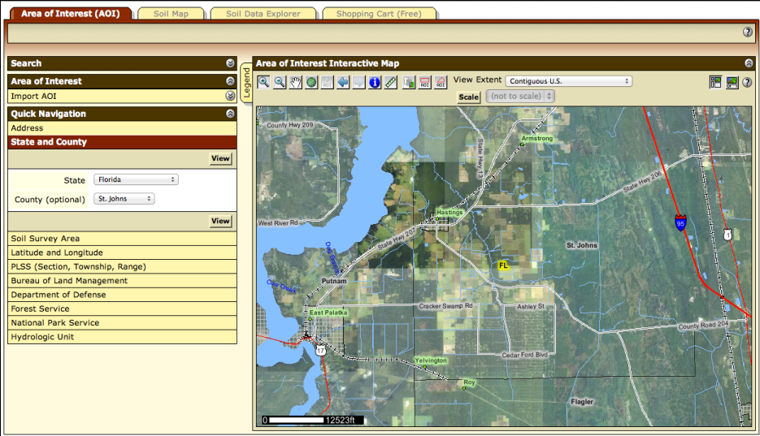
Step 7 – Zooming in

Slide 11
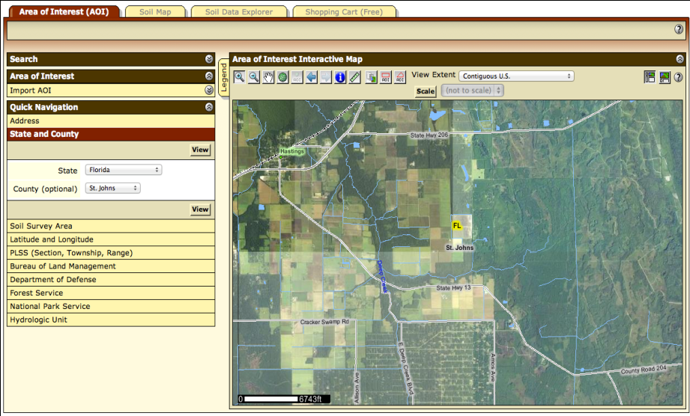
Step 8 – Zooming in

Slide 12
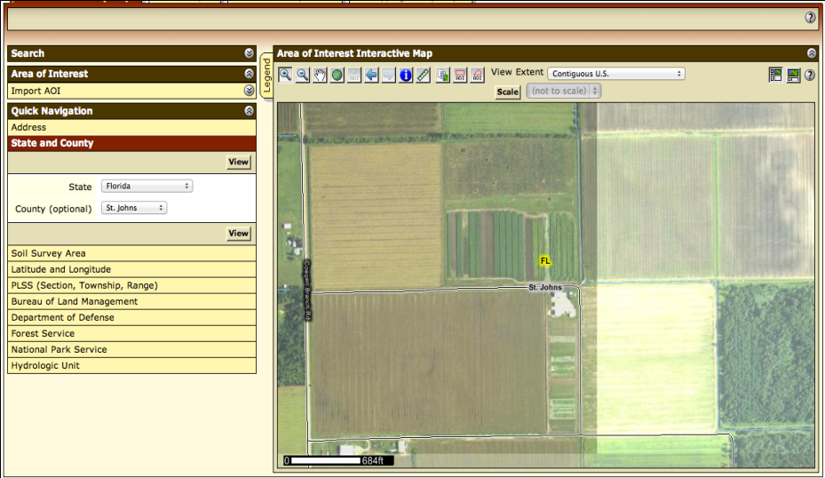
Step 9 – Locate your area.

Slide 13
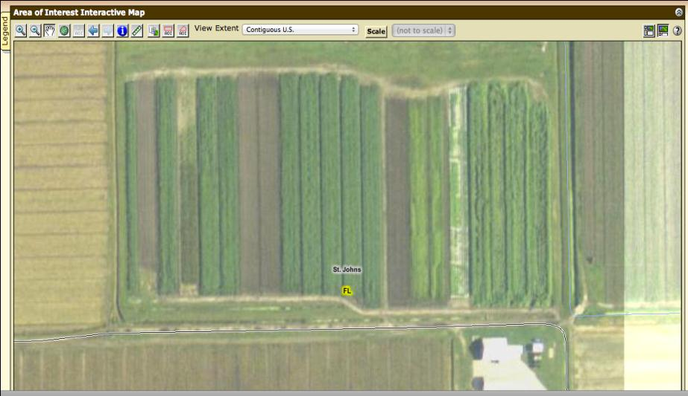
Step 10 – Identify the boundaries of AOI. Maximizing zoom by view map at full screen width

Slide 14
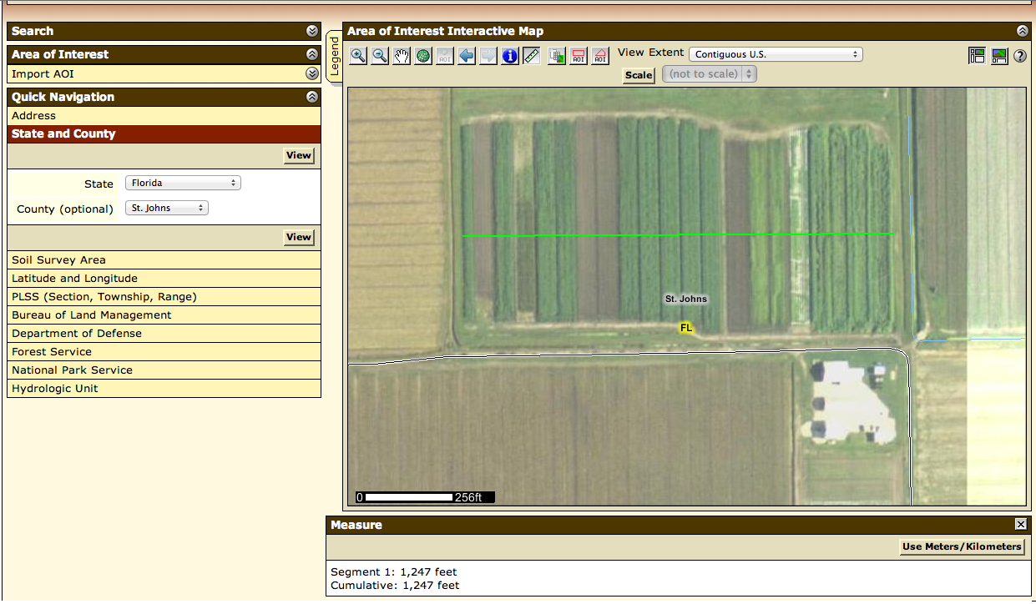
Step 11 - Linear Measuring Tool

Slide 15
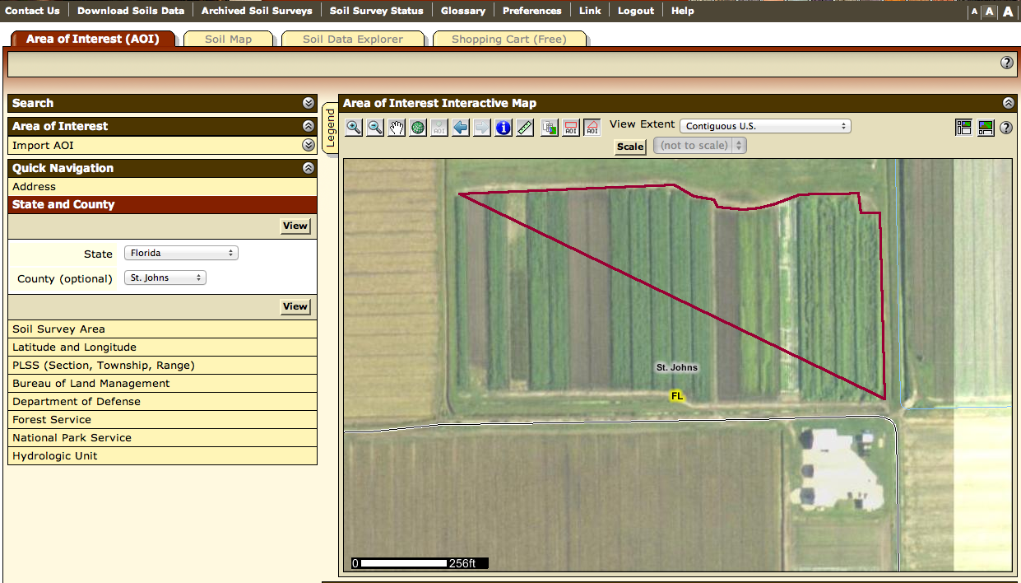
Step 12a. Drawing a polygon on a map and expanding rectangle

Slide 16
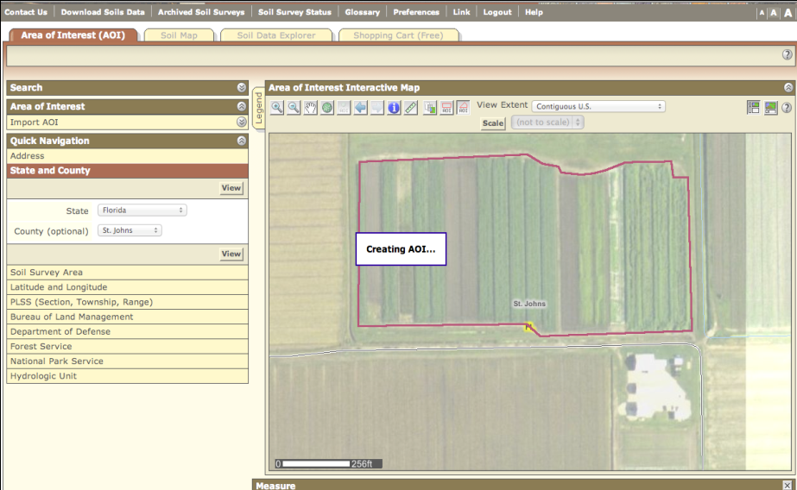
12b. Selecting a soil survey area

Slide 17
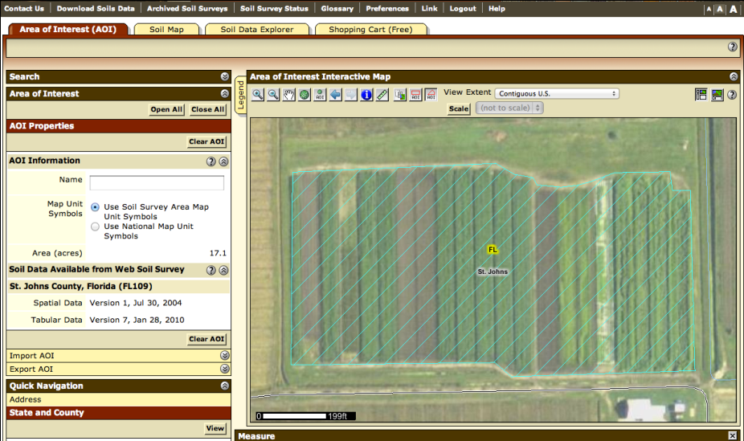
Step 13 - Display data available for defined AOI – ACREAGE AND SOIL MAP

Slide 18
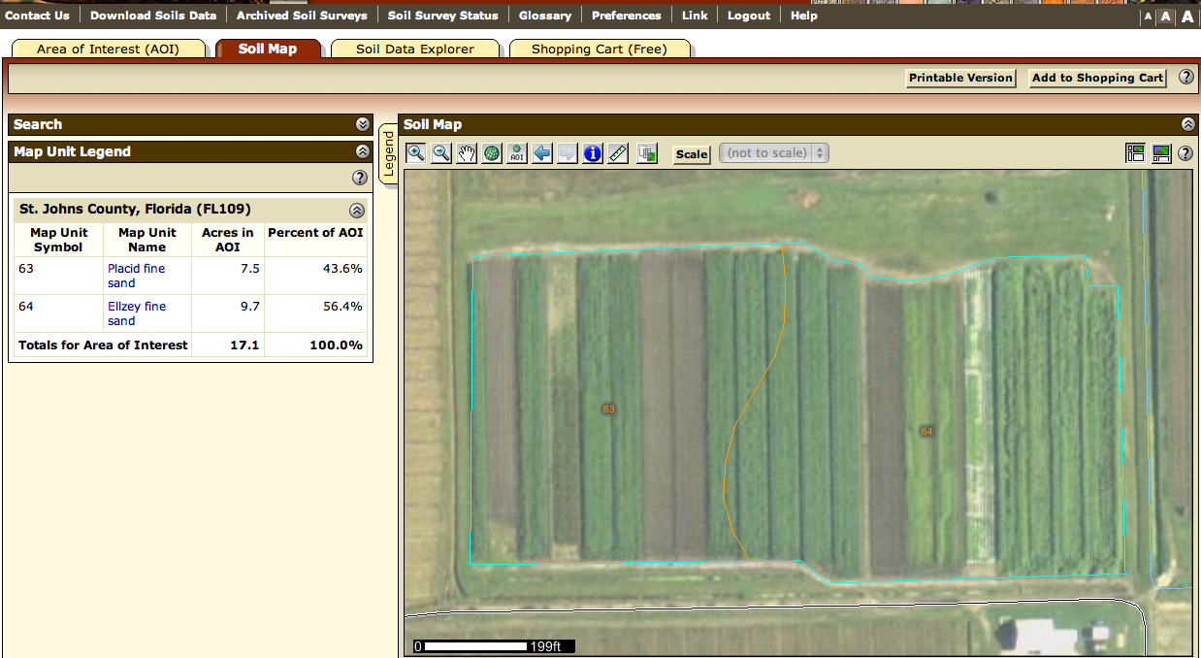
Step 14 – View soil map units.

Slide 19
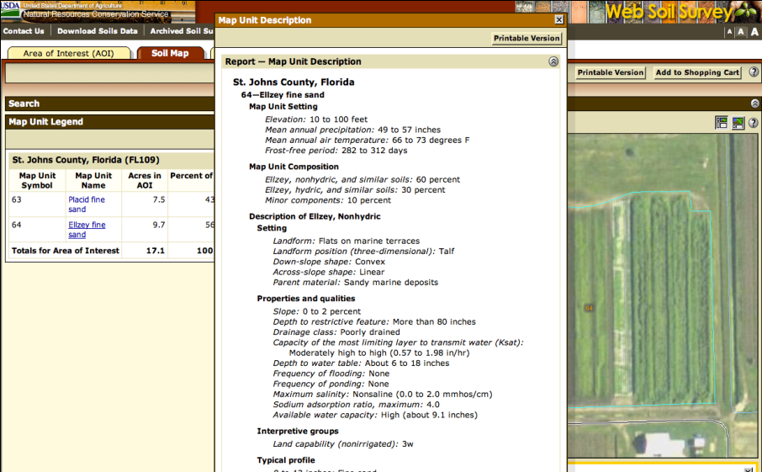
Step 15 - View Map Unit Description.

Slide 20
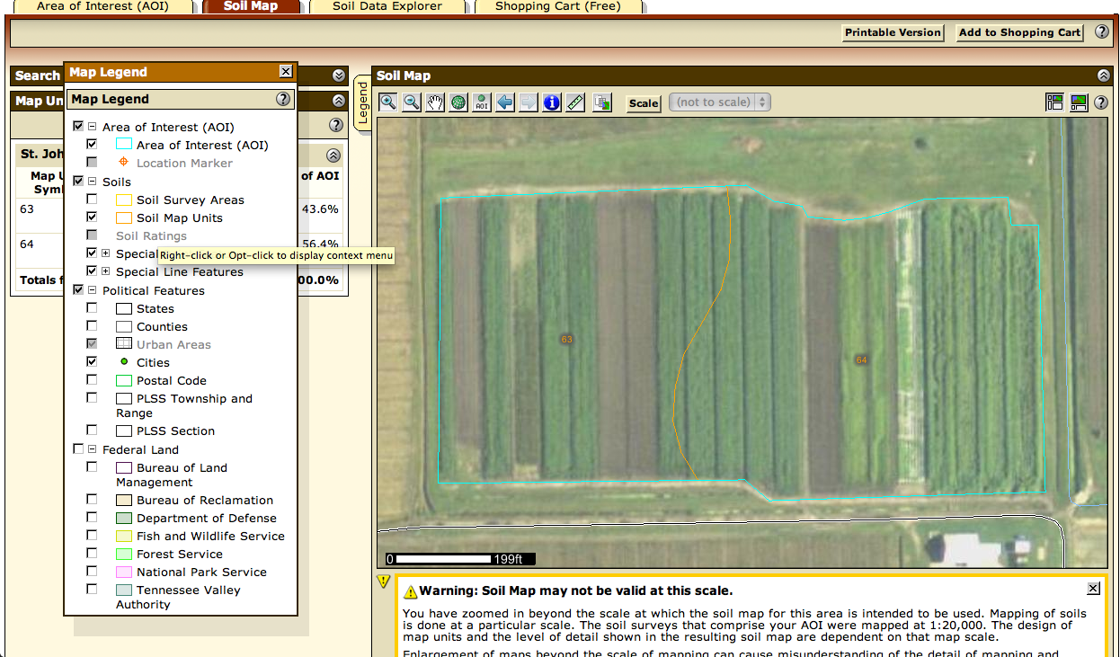
Step 16 – Expanding legend

Slide 21
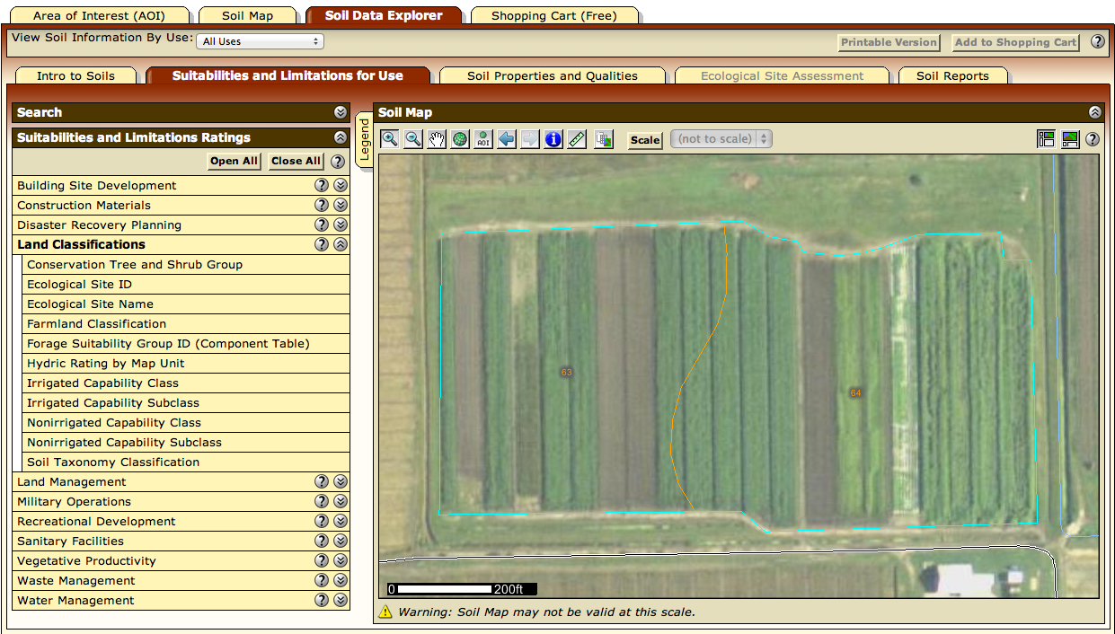
Step 17 – Explore Soil Data

Slide 22
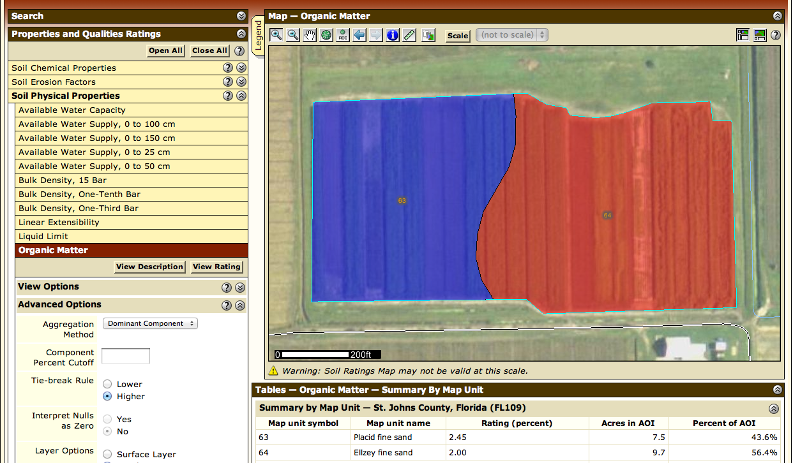
Step 18 – Example of soil properties maps based on soil series. Organic mater. (OPTIONAL)

Slide 23
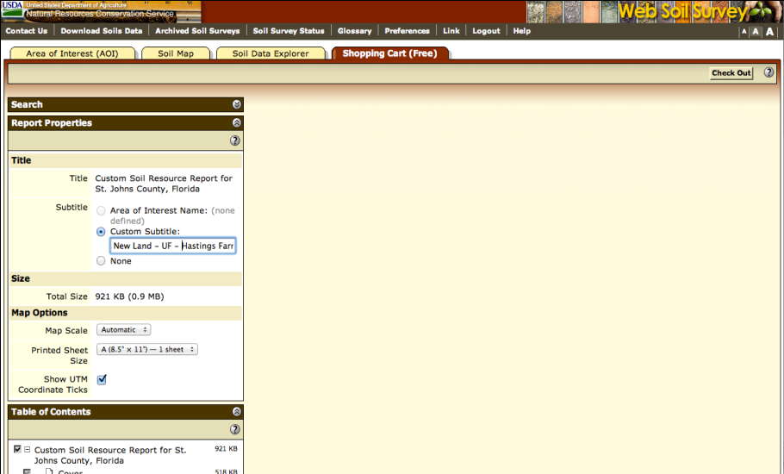
Step 19 - Shopping Cart (FREE) Step 20 – Shopping Cart – Custom Subtitle

Slide 24
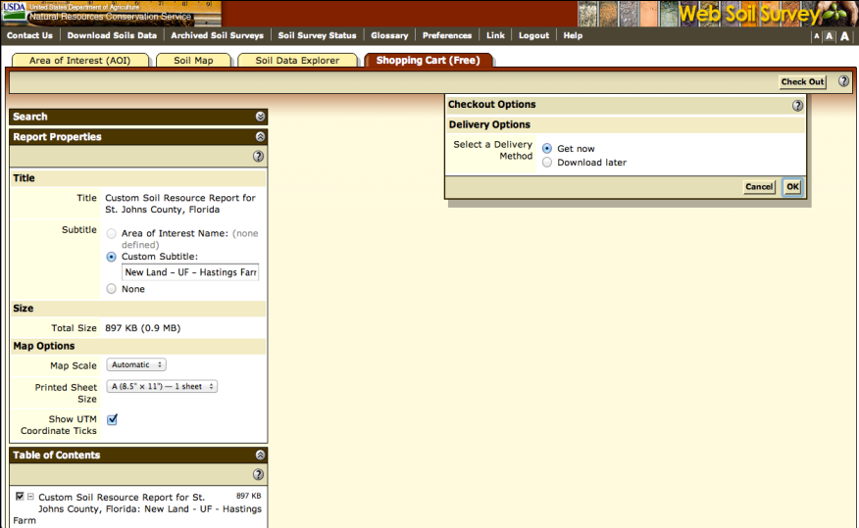
Step 21 – Delivery method.

Slide 25
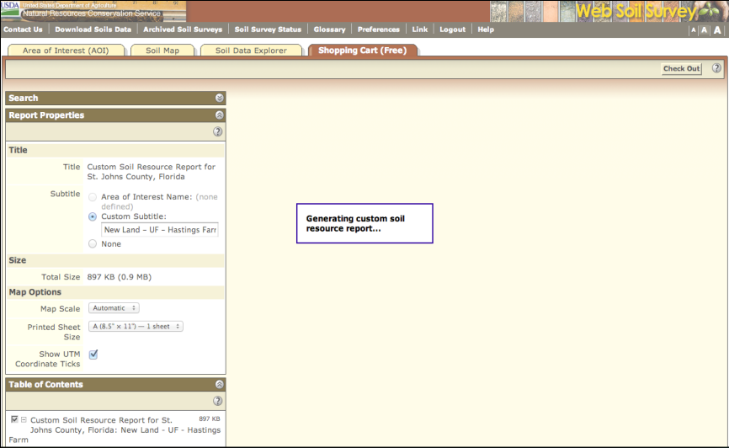
Step 22 - Generating custom soil resources report.

Slide 26
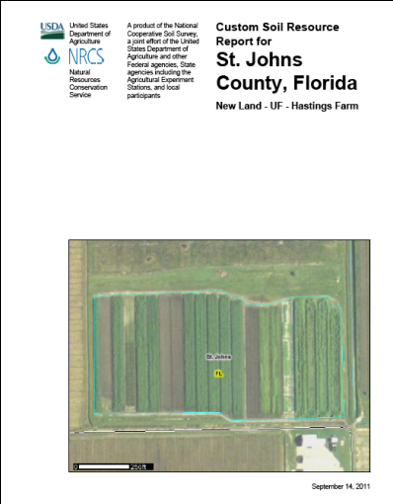
Step 23a – Review Report.

Slide 27
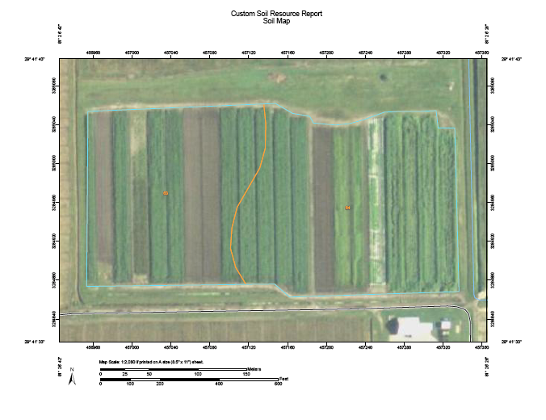
Step 23b – Review Report.

Slide 28
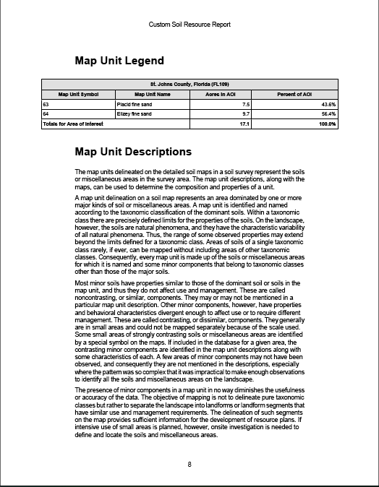
Step 23c – Review Report.

Slide 29
Questions?
Thank you!

