Slide 1
Organic Foods and Your Nutritional Health

Slide 2
Overview
Organic foods in the marketplace
Exploring your beliefs about organic foods
Let’s see what “organic” means
What do we know about the nutritional value of organic foods?
Take-home message

Slide 3
Organic Foods in the Marketplace
Fastest growing segment of food industry
J Food Sci 2006; 00:R1-R8.
Organic Trade Association, 2009

Slide 4
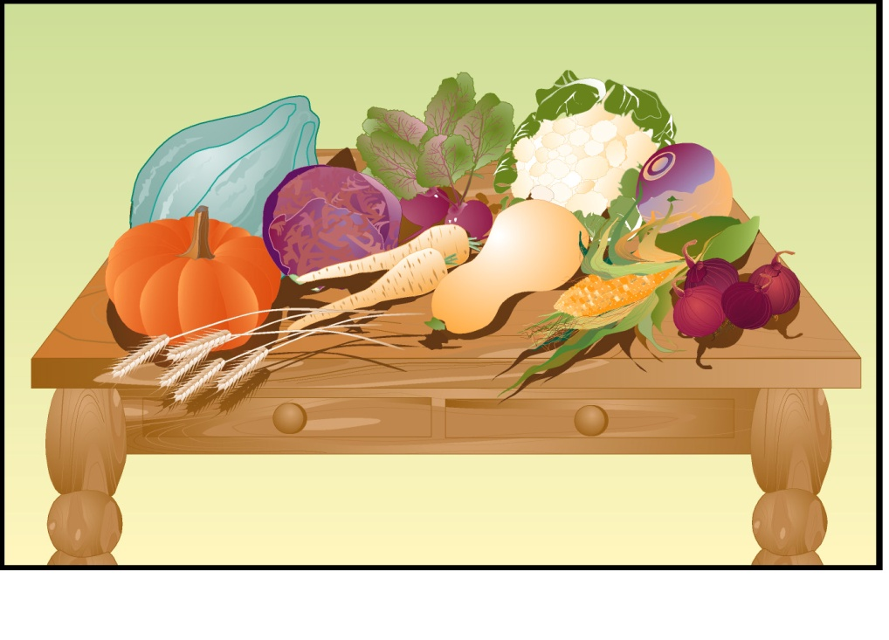
Organic Foods in the Marketplace
Fruits and vegetables lead sales, followed by dairy products and beverages.
J Food Sci 2006; 00:R1-R8.

Slide 5
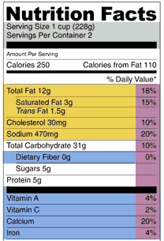
Organic Foods in the Marketplace
Many reasons why consumers buy organic foods.
Let’s see what YOUR beliefs are . . .

Slide 6

Do you agree or disagree?
1) All organically-produced foods are nutritionally superior to similar traditionally-produced foods.

Slide 7
Do you agree or disagree?
2) Organically-produced and traditionally- produced foods are essential the same nutritionally.

Slide 8
Do you agree or disagree?
3) Some organically-produced foods are nutritionally superior to similar traditionally-produced foods.

Slide 9
Do you agree or disagree?
4) The nutritional superiority of organically-produced foods results in health benefits for consumers who eat them.

Slide 10
Do you agree or disagree?
5) Certain plants grown organically contain higher levels of antioxidants than similar plants grown traditionally.

Slide 11
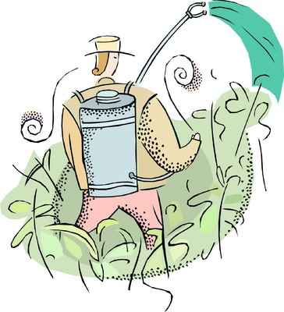
Understanding “Organic”
Looking back to the 1940’s:
Movement to avoid “chemical inputs” like pesticides in agriculture.
But, had no definitions or standards . . .
Understanding the ‘USDA Organic’ Label. EDIS pub HS1146, 2008

Slide 12
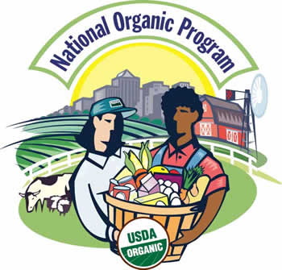
Understanding “Organic”
Need for federal standards emerged.
Legislation established:
  National Organic Program (NOP)
  National Organic Standards Board (NOSB)
Organic standards adopted in 2002.
Understanding the ‘USDA Organic’ Label. EDIS pub HS1146, 2008

Slide 13
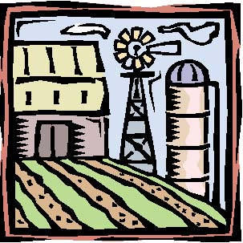

Understanding “Organic”
Organic agriculture: “an ecological production management system that promotes and enhances biodiversity, biological cycles, and soil biological activity.”
Let’s see what Gardening in a Minute says about organic gardening …
Understanding the ‘USDA Organic’ Label. EDIS pub HS1146, 2008

Slide 14
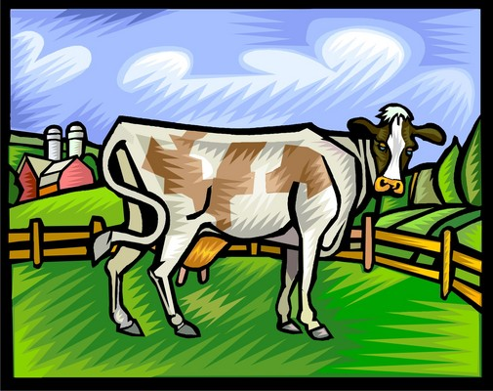
NOP Standards
Livestock
No preventive antibiotics or other synthetic drugs unless animal becomes sick
No growth-promoting hormones
Understanding the ‘USDA Organic’ Label. EDIS pub HS1146, 2008

Slide 15
NOP Standards
Pesticide use
No “high risk” ingredients
Residues from unapproved pesticides must be less than 5% of EPA tolerance level
IPM is one way to reduce pesticide use:

Slide 16
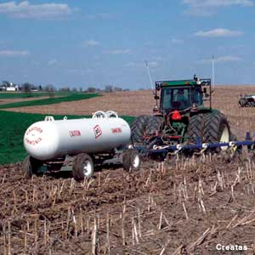
NOP Standards
Restrictions
Raw manure applications no less than 90-120 days prior to harvest
Compost manufacture is strictly regulated
May not use any genetically-modified crops
Understanding the ‘USDA Organic’ Label. EDIS pub HS1146, 2008

Slide 17
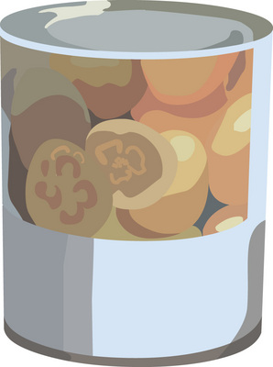
NOP Standards
Other
Processed organic foods generally contain no artificial flavors, colors, or preservatives

Slide 18
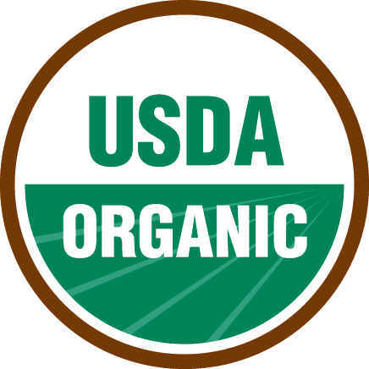
Organic Label
Producers who use the organic seal must be certified.
Categories for multi-ingredient products:
  100% organic
  Certified organic
  Made with organic ingredients
  No label claims
Understanding the ‘USDA Organic’ Label. EDIS pub HS1146, 2008

Slide 19
Research Interests
Effects of organic production on nutrient levels in foods
Impacts in humans of consuming organically produced foods:
  nutrient levels
  disease risk
  overall health
Key question to keep in mind: If organic products are nutritionally superior, does it matter in terms of human health?
J Sci Food Agric. 2001; 81:924-931.

Slide 20
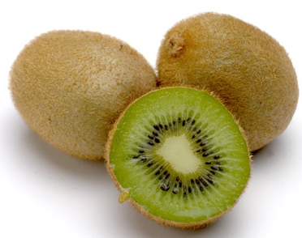
Antioxidants in Kiwifruit
Organic fruit kiwifruit had higher levels of:
  Several minerals
  Vitamin C (ascorbic acid)
  Phenolic compounds
J Sci Food Agric. 2007; 87:1228-36.

Slide 21
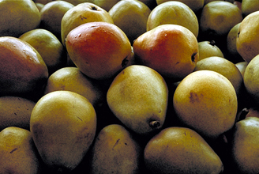
Antioxidants in Pears and Peaches
Vitamin E levels not consistently different.
Vitamin C higher in organic peaches.
Total phenolic activity higher in organic fruits.
J Agric Food Chem. 2002;50:5458-5462

Slide 22
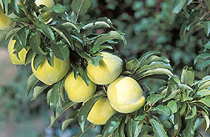
Antioxidants in Yellow Plums
Three types of organic cultivation used.
Vitamin C low in all groups.
Vitamin E levels not consistently different.
Total polyphenols higher in conventionally grown plums.
J Agric Food Chem. 2004;52:90-94.

Slide 23
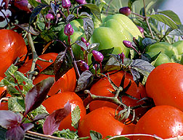
Antioxidants in Tomatoes
Fresh organic tomatoes higher in vitamin C, carotenoids, and polyphenols.
Organic purees higher in vitamin C and polyphenols.
Blood nutrient levels increased similarly.
J. Agric. Food Chem. 2004;52:6503-09

Slide 24
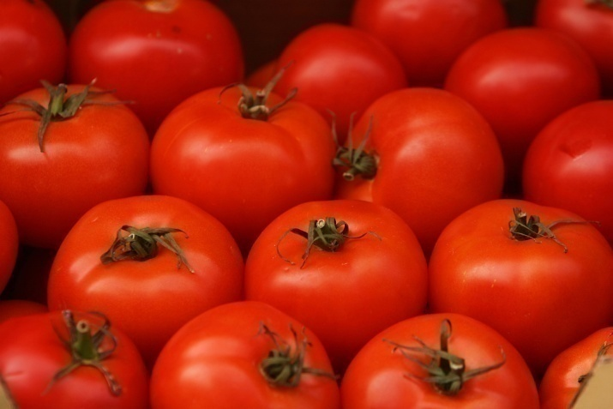
Flavonoids in Tomatoes
Ten-year study of flavonoid content in tomatoes.
Two flavonoids higher in organic samples.
J. Agric. Food Chem. Publ. on Web 6/23/2007

Slide 25
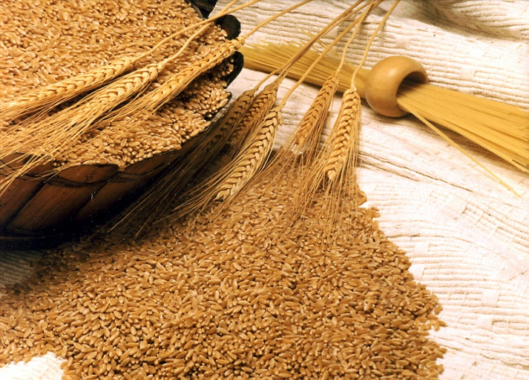
Comparison of Nutrient Levels in Variety of Foods
Review of 150 studies.
Foods: cereals, vegetables, fruits, bread, dairy, meat and meat products, eggs, honey, wine, and beer.
Either no major differences in nutrient levels or results inconclusive.
J. Sci. Food Agric. 1997;74:281-293.

Slide 26
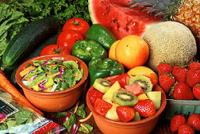
Comparison of Nutrient Levels in Fruits, Vegetables and Grains
Review of 41 studies.
Organically grown crops contained more:
  vitamin C
  iron, magnesium, and phosphorus
J. Alternative Compl. Med. 2001;7:161-173.

Slide 27
Recent Review
Screened published studies since 1980.
Compared levels of 11 nutrients.
Organic foods nutritionally superior in 61% and conventional in 37% of matched pairs.
Nutrient differences greater and more significant when organic food had higher levels.
Nutritional Superiority of Organic Food. The Organic Center. March 2008

Slide 28
Understanding Higher Levels of Phytochemicals
Why would organic foods contain higher levels of compounds such as polyphenols?
Two ideas:
  Less availability of nitrogen for plants in organic fertilization practices.
  Greater chemical response to environmental stresses by organic plants.
J Food Sci 2006; 00:R1-R8.

Slide 29

Need for Research
“Valid, reliable, objective studies are needed of the differences between organic and conventional foods in levels of human nutrients, and of the impacts of those differences on human health.”
First World Congress on Organic Food – 2004

Slide 30
Take Home Message
Hunger and Environmental Nutrition DPG, 2007 www.HENdpg.org
Certain plants cultivated in an organic system contain higher levels of antioxidants.

Slide 31
Consumers are confused.
Many are afraid.
Some also have too much time on their hands . . .
28

Slide 32
Can't eat

Slide 33



Can't eat beef ... Mad Cow

Slide 34
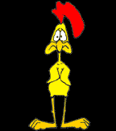
Can't eat chicken ... Bird flu

Slide 35
Can't eat eggs .
Salmonella

Slide 36
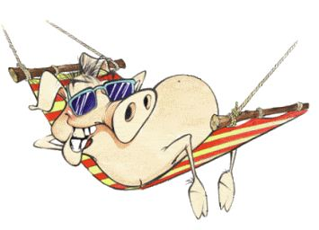
Can't eat pork ..
trichinosis

Slide 37






Can't eat fish ..
Mercury and other heavy metals

Slide 38
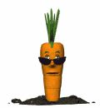
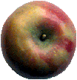



Can't eat fruits and veggies ...
insecticides and herbicides

Slide 39
Hmmmmmmmmm!
M
M
M
M
M
M
M
M
M
M

Slide 40
I believe
that leaves

Slide 41
Chocolate!

Slide 42
Seriously though,
are there any questions?

Slide 43
Slide set prepared by:
Linda B. Bobroff, Ph.D., RD, LD/N
Professor and Extension Nutrition Specialist
Department of Family, Youth & Community Sciences
University of Florida IFAS Extension
May 2009

