Slide 1
Evapotranspiration Controllers
in Florida
Dan Rutland, B.S., E.I.
Agricultural & Biological Engineering
Institute of Food and Agricultural Sciences (IFAS)‏
Landscape Fundamentals IST
Wimauma, FL, Feb 10, 2009
Notes:
1
Build Green & Profit
1

Slide 2
Outline
Evapotranspiration
Weather Based Irrigation Controllers
Rain Features
Project Overview
Results
Photo credit: Microsoft Office Clip Art

Slide 3
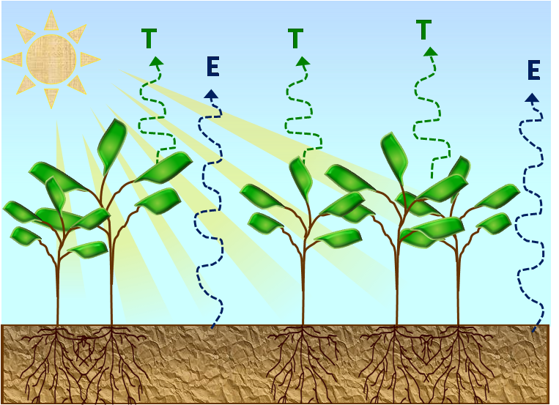
Evapotranspiration
Evapotranspiration
the combination of total evaporation from the soil and soil surface and transpiration from the representative vegetation in the area
Image credit: Mary Shedd McCready

Slide 4
Evapotranspiration
Evapotranspiration
the combination of total evaporation from the soil and soil surface and transpiration from the representative vegetation in the area
Image credit: Mary Shedd McCready

Slide 5
Evapotranspiration
Evapotranspiration
the combination of total evaporation from the soil and soil surface and transpiration from the representative vegetation in the area
ET values can be calculated using:
Temperature
Relative Humidity
Wind Speed
Solar Radiation
Image credit: Mary Shedd McCready

Slide 6
Weather Based Irrigation Controllers (ET Controllers)
ET Controllers apply irrigation as needed based on weather conditions
The soil water balance is managed so that the water availability always meets the needs of the plant.
ET Controllers use plant and irrigation settings to determine irrigation run times
Sun and Shade
Soil Type
Plant Type
Sprinkler Type
Slope

Slide 7
Soil Water Balance
Field Capacity (FC)
maximum amount of water a soil may hold before draining
Permanent Wilting Point (PWP)
soil water content that will result in plant death
Available Water (AW)

Slide 8
Soil Water Balance
Field Capacity (FC)
maximum amount of water a soil may hold before draining (10 kPa)
Permanent Wilting Point (PWP)
soil water content that will result in plant death
Available Water (AW)

Slide 9
Soil Water Balance
Field Capacity (FC)
maximum amount of water a soil may hold before draining (10 kPa)
Permanent Wilting Point (PWP)
soil water content that will result in plant death (1500 kPa)
Available Water (AW)

Slide 10
Soil Water Balance
Field Capacity (FC)
maximum amount of water a soil may hold before draining (10 kPa)
Permanent Wilting Point (PWP)
soil water content that will result in plant death (1500 kPa)
Available Water (AW)
amount of water soil can hold in the root zone

Slide 11
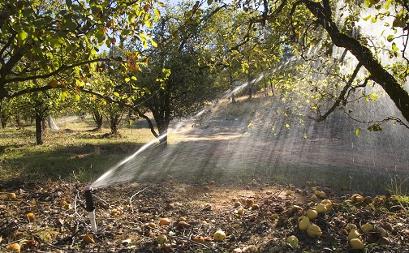
Soil Water Balance
Readily Available Water (RAW)
The portion of available water that can be used by the plant before yield and growth become inhibited
Determined by the Maximum Allowable Depletion (MAD) factor for the specified crop
Photo courtesy of USDA NRCS

Slide 12
Soil Water Balance
Readily Available Water (RAW)
The portion of available water that can be used by the plant before yield and growth become inhibited
Determined by the Maximum Allowable Depletion (MAD) factor for the specified crop
Photo courtesy of USDA NRCS

Slide 13
Soil Water Balance
Soil Column

Slide 14
Soil Water Balance
Soil Column
Saturation

Slide 15
Soil Water Balance
Soil Column
Saturation
Field Capacity

Slide 16
Soil Water Balance
Soil Column
Saturation
Field Capacity
Permanent Wilting Point

Slide 17
Soil Water Balance
Soil Column
Saturation
Field Capacity
Available Water
Permanent Wilting Point

Slide 18
Soil Water Balance
Soil Column
Saturation
Field Capacity
Maximum Allowable Depletion
Available Water
Permanent Wilting Point

Slide 19
Soil Water Balance
Soil Column
Saturation
Field Capacity
RAW
Maximum Allowable Depletion
Available Water
Permanent Wilting Point

Slide 20
Types of ET Controllers
Historical Based
Uses historical ET values for the region
On-Site Calculation
Uses on site instruments to do immediate ET calculations for the given area
Signal Based
Uses pager or cellular technology to send ET values to the controllers

Slide 21
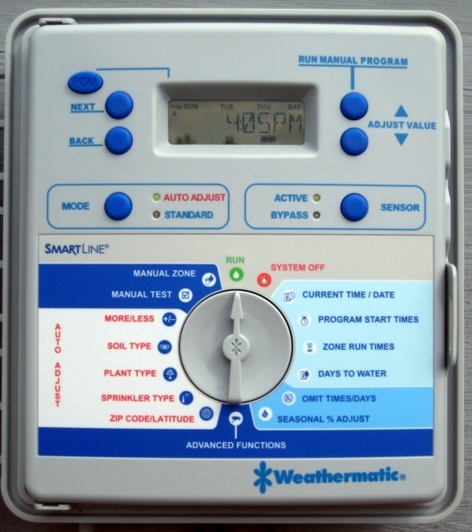
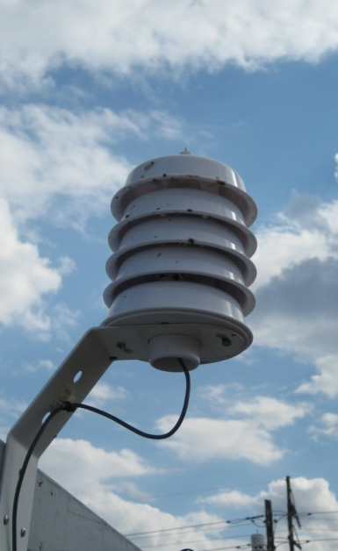
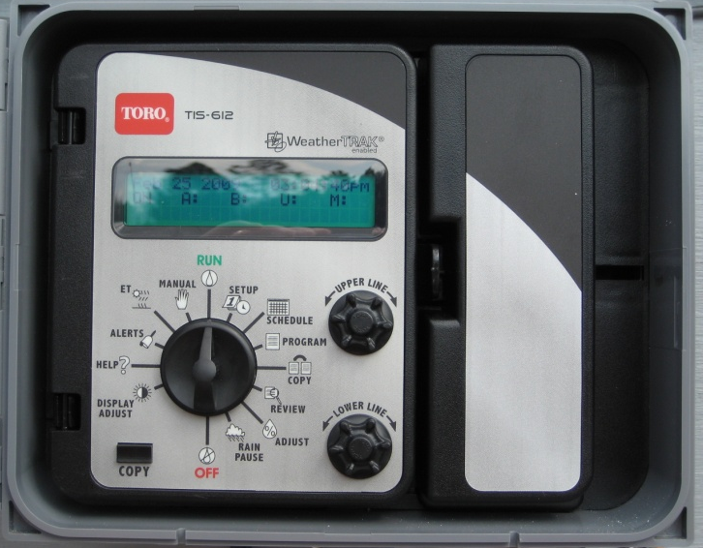
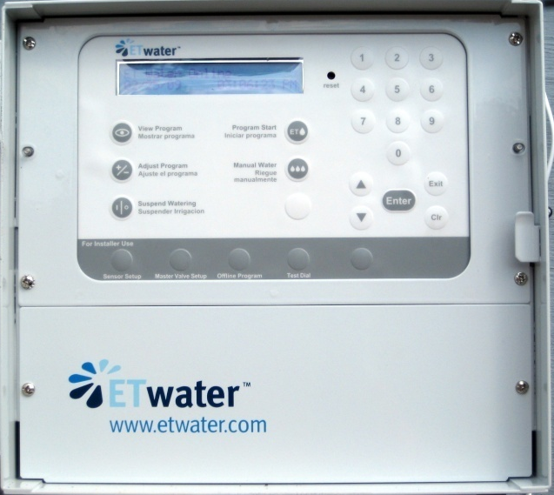
ET Controllers
Stand Alone
Weathermatic SL1600
Signal Based
Toro Intelli-Sense
ETwater
Photo credits: Mary Shedd McCready

Slide 22
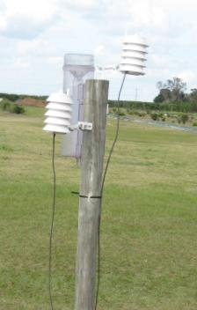
Weathermatic ET Controller
Stand-alone controller with proprietary onsite weather monitor
Irrigates based on lost ET for the previous day
Will Irrigate every day if allowed to do so
Photo credit: Dan Rutland

Slide 23
Soil Water Balance
WeatherMatic
Day 1
Soil Column
Saturation
Field Capacity
RAW
Maximum Allowable Depletion
Available Water
Permanent Wilting Point

Slide 24
Soil Water Balance
WeatherMatic
Day 2
Before Irr.
Soil Column
Saturation
Field Capacity
RAW
Maximum Allowable Depletion
Available Water
Permanent Wilting Point

Slide 25
Soil Water Balance
WeatherMatic
Day 2
After Irr.
Soil Column
Saturation
Field Capacity
RAW
Maximum Allowable Depletion
Available Water
Permanent Wilting Point

Slide 26
Toro Intelli-Sense ET controller
Irrigates based on Weather Conditions
Manages the Soil Water Balance
Irrigates based on Soil water Depletion
Receives Evapotranspiration data via pager technology from Hydropoint
Values sent to controller daily
Photo credit: Mary Shedd McCready

Slide 27
Soil Water Balance
Toro
Day 1
Soil Column
Saturation
Field Capacity
RAW
Maximum Allowable Depletion
Available Water
Permanent Wilting Point

Slide 28
Soil Water Balance
Toro
Day 2
Soil Column
Saturation
Field Capacity
RAW
Maximum Allowable Depletion
Available Water
Permanent Wilting Point

Slide 29
Soil Water Balance
Toro
Day 3
Soil Column
Saturation
Field Capacity
RAW
Maximum Allowable Depletion
Available Water
Permanent Wilting Point

Slide 30
Soil Water Balance
Toro
Day 4
Before Irr.
Soil Column
Saturation
Field Capacity
RAW
Maximum Allowable Depletion
Available Water
Permanent Wilting Point

Slide 31
Soil Water Balance
Toro
Day 4
Before Irr.
Soil Column
Saturation
Field Capacity
RAW
Maximum Allowable Depletion
Available Water
Permanent Wilting Point

Slide 32
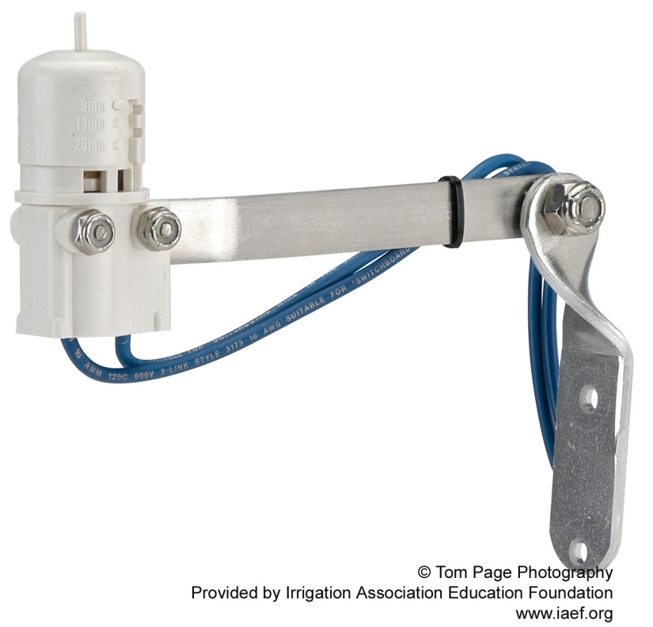
Toro Rain Features
Toro Intelli-Sense
Has a Rain Pause Feature
Controlled by weather service
Can be managed by usable rainfall feature
For example:
If the weather service sends out a rain pause for 6 days, and the usable rainfall setting is 50% then irrigation will be pause for 3 days.
Has attachable rain shut-off device connections
Stops Irrigation during precipitation events of a predetermined magnitude

Slide 33
Project Goals
Photo credit: Dan Rutland
Quantify the effect of rain shut off devices and programming on irrigation application by ET controllers
Compare and contrast two brands of ET controllers with respect to irrigation depth applied, ET values and ability to maintain turf quality
Evaluate ET controller performance compared to a daily soil moisture balance
Create homeowner friendly guide to programming ET controllers

Slide 34
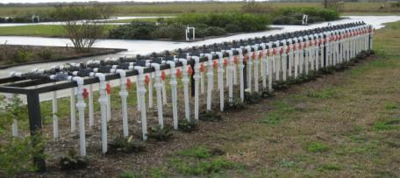
Project Site
Located at the Gulf Coast Research and Education Center (GCREC)
20 plots with 650 ft² of St. Augustine turfgrass (Stenotaphrum secundatum)
Each plot has a dedicated flow meter and soil moisture sensors
All measurements are collected by dataloggers
Photo credit: Dan Rutland

Slide 35
Plot Layout
Photo credit: Dan Rutland

Slide 36
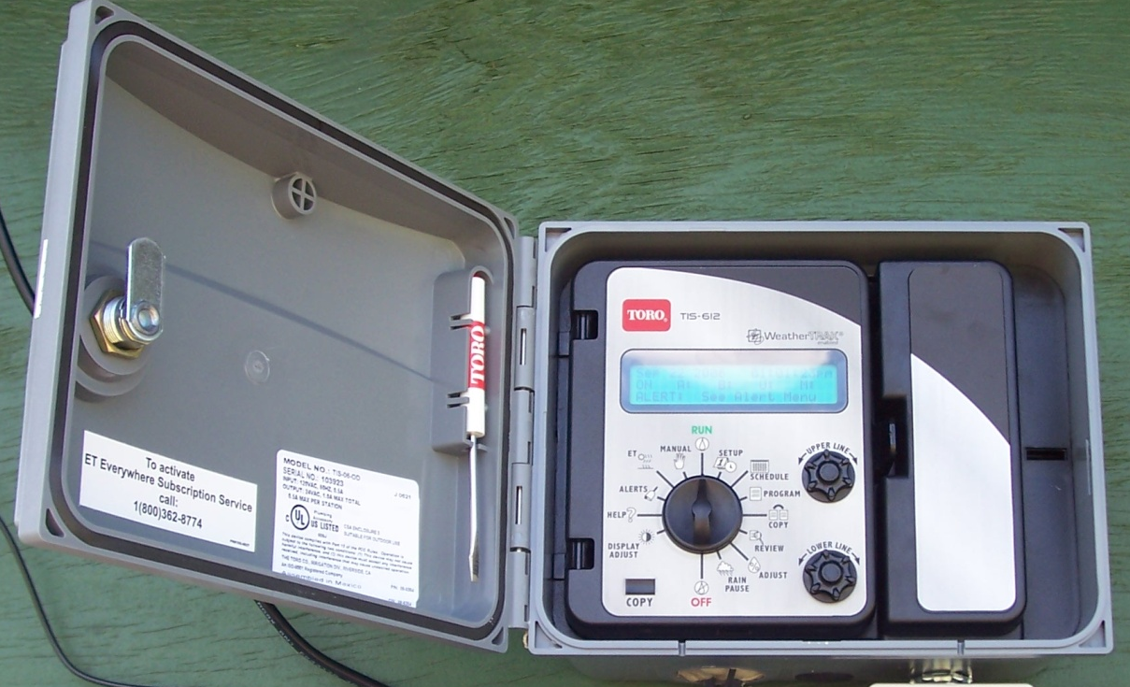
Controllers and Treatments
Toro A (Outdoor Model)
Has a Hunter Mini-Clik rain sensor attached
Toro B (Indoor Model)
Has no rain sensor
Outdoor Model
Photo credit: Mary Shedd McCready

Slide 37
WeatherMatic SL1600
Three day a week schedule
Monday
Wednesday
Saturday
Has a rain sensor included on the weather monitor
Photo credit: Mary Shedd McCready

Slide 38
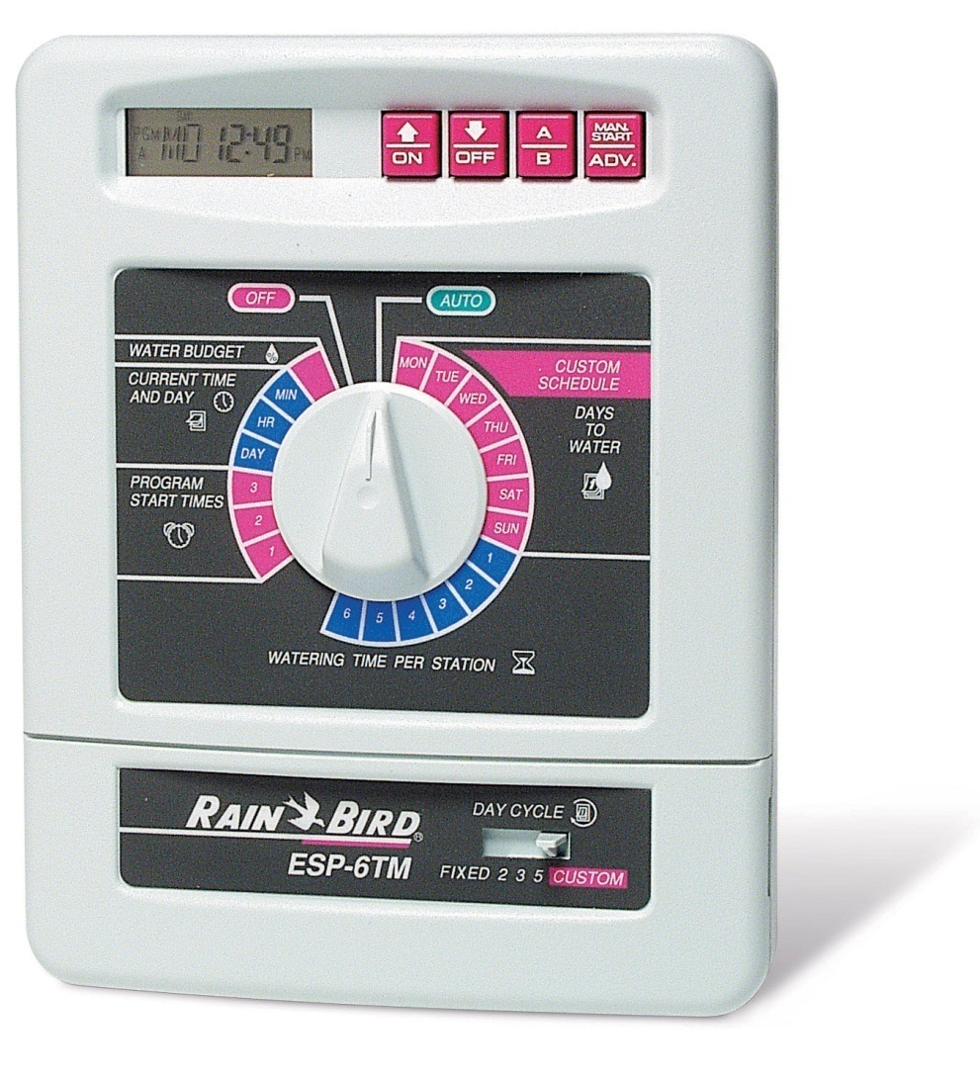
Control Treatments
Rainbird Irrigation timer
is set with recommended run times for the given area
has a 60 percent of recommended irrigation treatment
Photo credit: IAEF.org

Slide 39
Research Results
Time Period of May 2006 to November 2007
The ET controllers averaged 35%-43% in water savings
The results showed that:
Consistent water savings are more likely by using ET controllers compared to average homeowner practices
There was no relationship between water application and turfgrass quality. More potential savings?
Photo credit: Mary Shedd McCready

Slide 40
Review
ET controllers use ET values for the representative area to schedule irrigation events
WeatherMatic Controllers work best under irrigation restrictions
Toro Controllers work best with all days available for irrigation
ET controllers save water in comparison to normal recommended irrigation schedules

Slide 41
Questions?
Photo by Lynn Betts, USDA Natural Resources Conservation Service

