Slide 1
Irrigation Myth Busters
Agricultural & Biological Engineering
Institute of Food and Agricultural Sciences (IFAS)‏
Landscape Fundamentals IST
Wimauma, FL, Feb 10, 2009
Notes:
1
Build Green & Profit
1

Slide 2

Myth: Irrigation is NOT Needed in Florida Landscapes
Irrigation is needed for establishment of most plants
For good quality of most landscapes, some form of supplemental irrigation is required
Myth

Slide 3
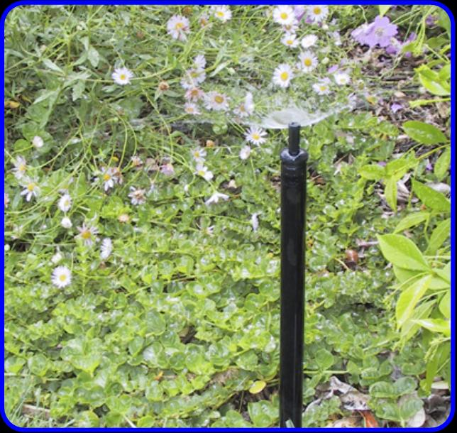
Name This Device
Microspray
Photo credit: IAEF.org

Slide 4
Did you know?
Water use and supply is sometimes measured in millions of gallons/day (mgd).
A million gallons is roughly equal to 20,000 full bathtubs
Photo credit: Microsoft Clip Art

Slide 5
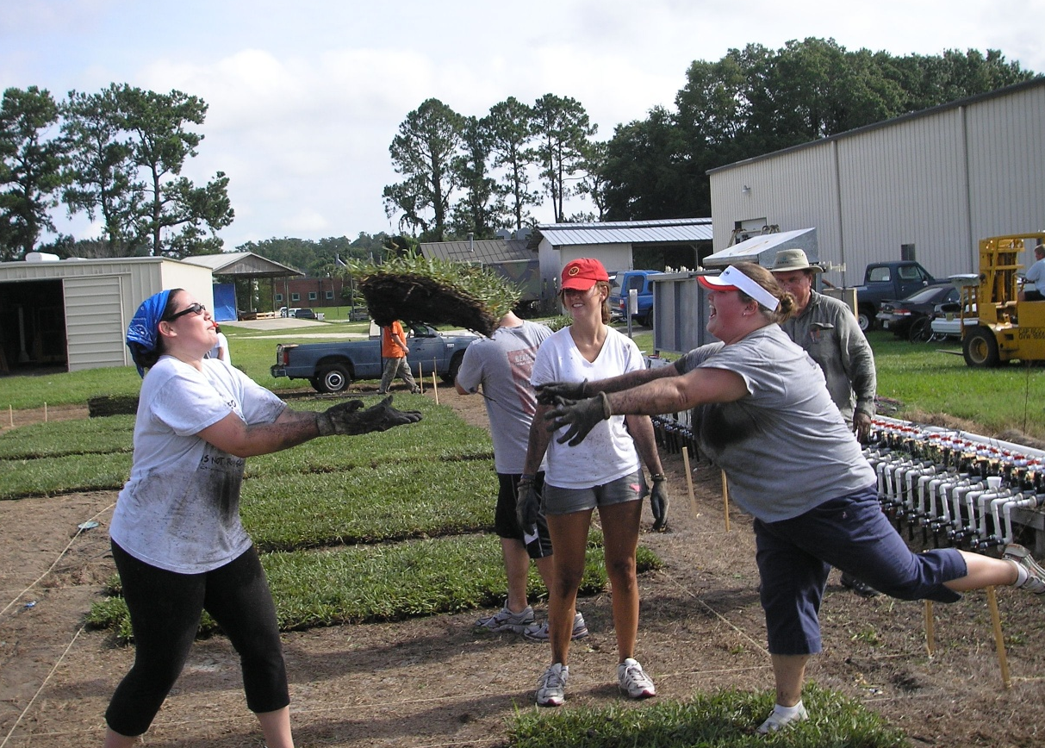
Did you know?
In 1992, turfgrass covered 4.4 million acres of Florida
Photo credit: Michael D. Dukes

Slide 6
Myth: Turfgrass has no beneficial atributes
FACT: Turfgrass can
  Moderate temperature
  Prevent soil erosion from wind and water
  Provide a recreational area
Myth

Slide 7
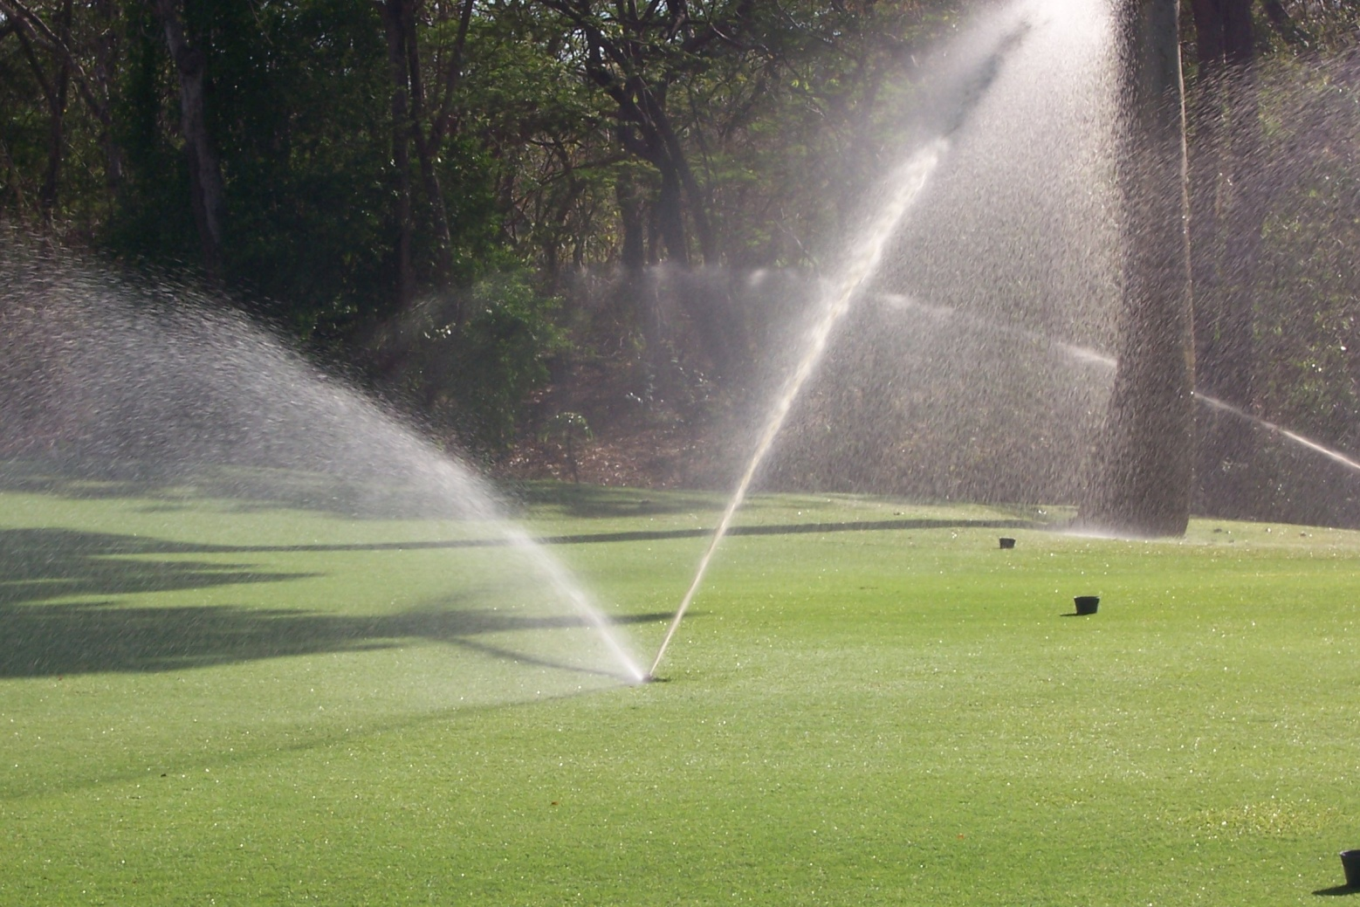
Name This Device
Rotors
Photo credit: Mary McCready

Slide 8

Myth: Watering restrictions save water
FACT: In 2007, in SFWMD going from three day to one day-per-week restrictions saved up to 20%.
Myth

Slide 9
Did you know?
Outdoor water use accounts for 25% to 75% of domestic water use in Florida, depending on the time of year.

Slide 10
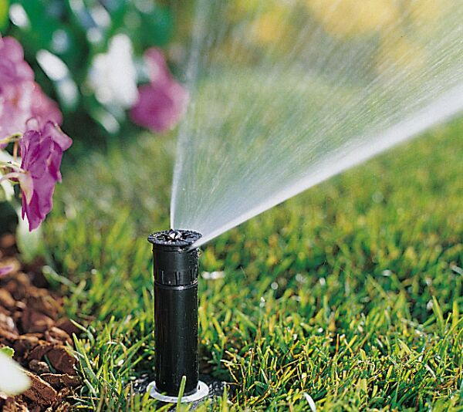
Name This Device
Spray Head
Photo credit: IAEF.org

Slide 11
Myth: Rain Sensors Don’t Work!
FACT: In homes, they can save 10-15% water during dry weather and 20-35% during wet weather
FACT: Continues to function after >3 years of use.
Myth

Slide 12
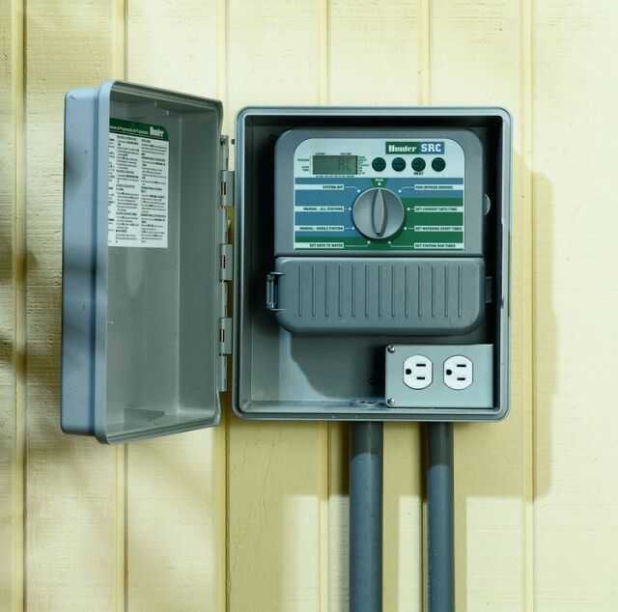
Name This Device
Controller
Photo credit: IAEF.org

Slide 13
Myth: Irrigation systems need a soil moisture sensor AND a rain sensor
FACT: Both are capable of saving water on their own. No need to have both.
Myth

Slide 14
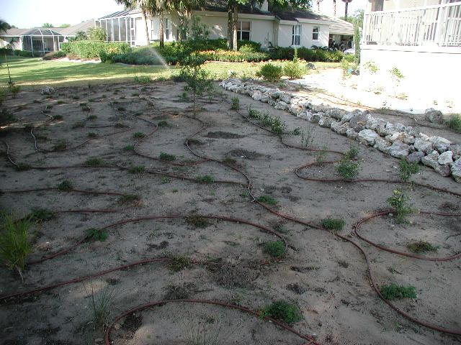
Name This Device
Drip Tubing
Photo credit: IAEF.org

Slide 15
Myth: Watering restrictions prevent over-irrigation
FACT: On the irrigation day, over-irrigation can still occur.
Myth

Slide 16
Did you know?
In 2005, Floridians paid an average potable water charge of $15/month compared to
  $49 – Cable TV
  $59 – Soda and other drinks

Slide 17
Myth: Microirrigation saves water
If properly scheduled and designed, this is true.
FACT: Changing from 100% sprinkler irrigation to 65% microirrigation resulted in 50% water savings.
Myth

Slide 18
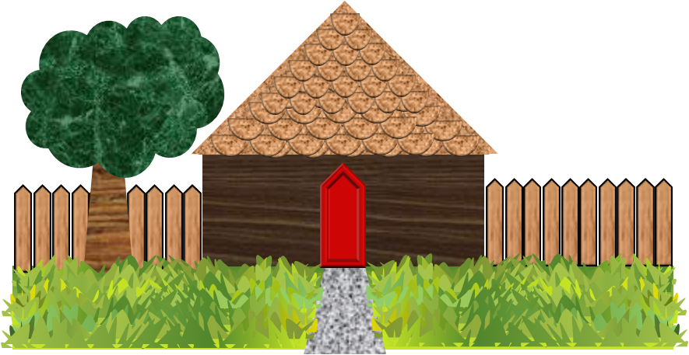

Did you know?
Florida uses 8.2 billion gallons of water per day.
  Residential irrigation accounts for 1 billion gallons per day.
Photo Credit: Mary Shedd McCready

Slide 19
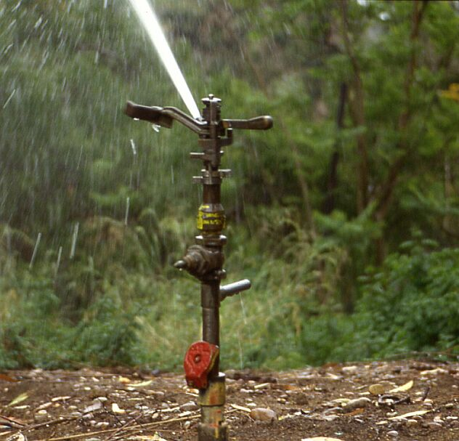
Name This Device
Impact
sprinkler
Photo credit: IAEF.org

Slide 20
Myth: Landscape plant ordinances save water.
FACT: Landscaping ordinances in Southwest Florida have not saved water.
Unlikely if still using an automatic irrigation system and have bad watering habitsMyth
Myth

Slide 21
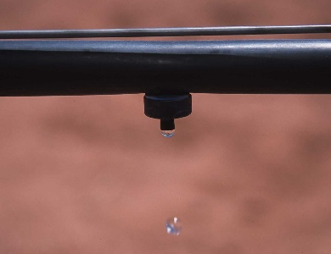
Name This Device
Drip Emitter
Photo by Jeff Vanuga, USDA NRCS

Slide 22
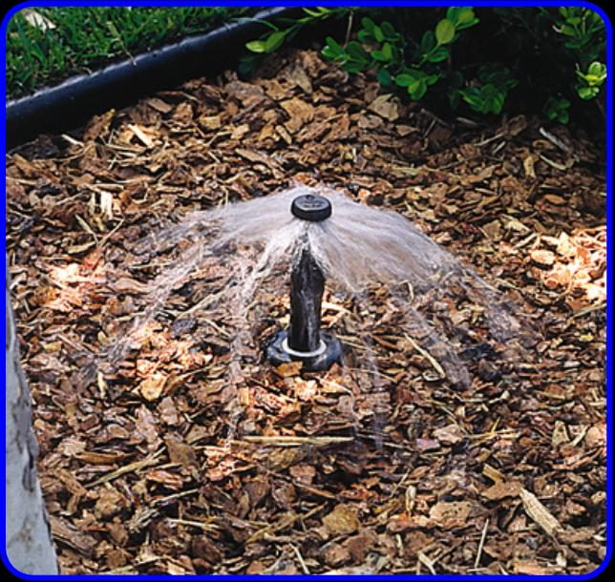
Name This Device
Bubbler
Photo credit: IAEF.org

Slide 23
Myth: Soil moisture sensors aren’t worth the money.
FACT: Water savings with SMS systems in residential landscapes has shown a payback period of less than 2 years
Myth

