Slide 1
Irrigation Scheduling
Melissa Baum Haley, M.E., E.I.
Agricultural & Biological Engineering
Institute of Food and Agricultural Sciences (IFAS)‏
Landscape Fundamentals IST
Wimauma, FL Feb 10, 2009
Notes:
1
Build Green & Profit
1

Slide 2
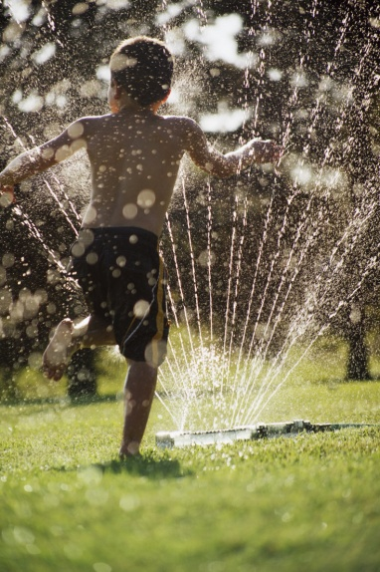
Irrigation Scheduling
The answers are based on:
  water need of particular plants in the landscape, as influenced by the environment and other site-specific factors such as soil, root zone depthand local weather conditions
How much water should be applied?
When should it be applied?
Photo credit: Microsoft Clip Art
Notes:
The answers are based on:
water need of particular plants in the landscape, as influenced by the environment and other site-specific factors such as soil, root zone depth and local weather conditions

Slide 3
Basics of Scheduling
Irrigation Scheduling

Slide 4


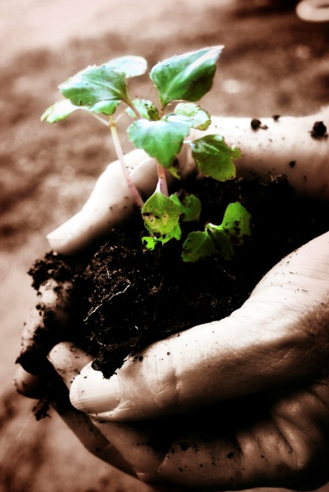
Basics of Scheduling
Evapotranspiration
Rainfall
Soil/Plant system
Photo credit: Microsoft Clip Art
Notes:
Photo credits: clip art

Slide 5
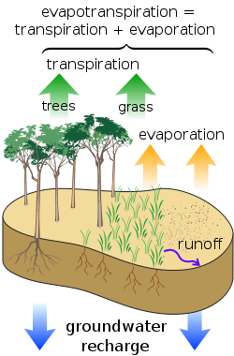
Evapotranspiration
Evapotranspiration is the total water lost from the soil and plant surface (evaporation) and water used by the plants (transpiration) over some time period.
Notes:
Photo credit: n/a (Creative Commons license)

Slide 6
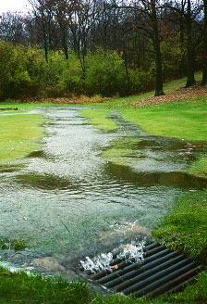
Rainfall
Effective rainfall is the fraction of the total amount of precipitation which remains in the root zone and available to the plant.
Not rainfall that: contributes to runoff, evaporations, or deep percolation.
Photo credit: James M. Pease
Notes:
In other words, the effective rainfall is the total rainfall minus runoff,minus evaporation,and minus deep percolation; only the water retained in the root zone can be used by the plants, and represents what is called the effective part of the rainwater. The term effective rainfall is used to define this fraction of the total amount of rainwater useful for meeting the water need of the crops.

Slide 7
Effective Rainfall (Re)
Only the rainfall that remains in the root zone is effective.
The rest results in runoff or drainage (deep percolation).
Effective Rainfall, Re
Surface Runoff, RO
Root
Zone,
RZ
Drainage by
Deep Percolation, D
Photo Credits: Mary McCready

Slide 8
How the basics fit together
The irrigation amount is calculated by the amount of water needed according to a soil water balance
Effective Rainfall, Re
ETc
Irrigation, I
Surface Runoff, RO
Re + I – ET – D – RO = 0
For now lets assume completely efficient water application( there is no drainage and no runoff) so
Root
Zone,
RZ
I = ET – Re
Drainage by
Deep Percolation, D
That makes the amount of irrigation necessary the deference between the evapotranspiration and effective rainfall
Photo Credits: Mary McCready

Slide 9
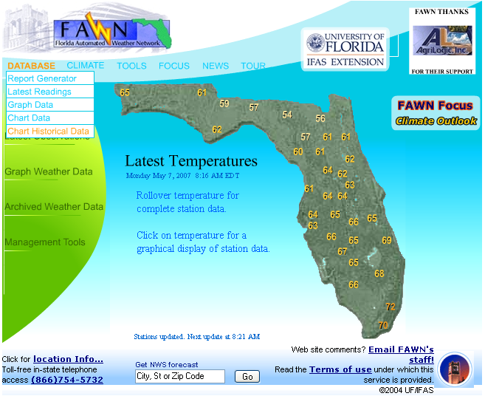
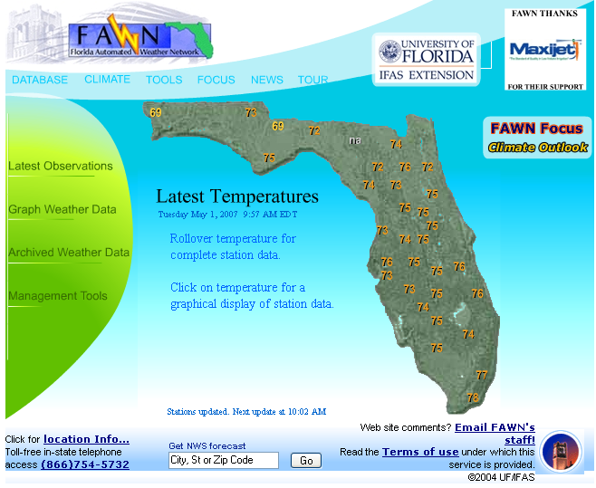
Where to find ET for your area
Pull Down:
Database
Choose:
Chart Historical Data

Slide 10
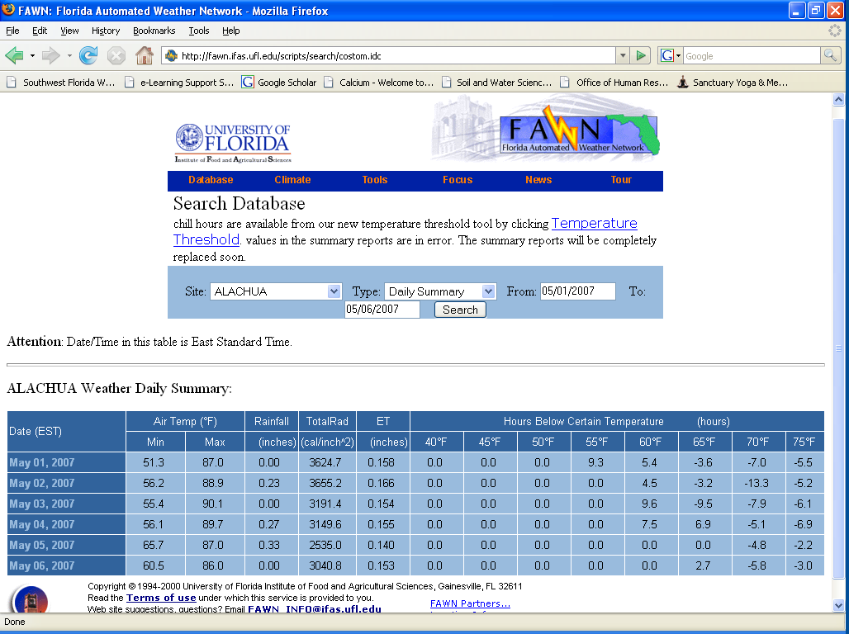
Where to find ET for your area

Slide 11
Soil hydraulic properties
Irrigation Scheduling

Slide 12
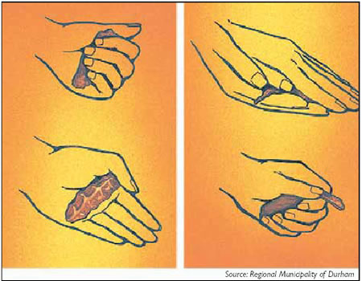

Soil Feel and Appearance
Photo credit: Microsoft Clip Art

Slide 13
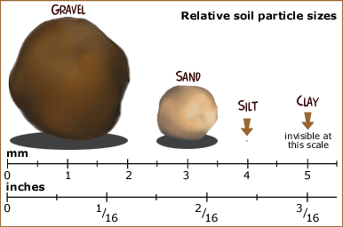
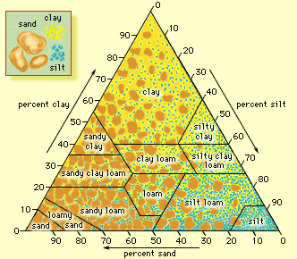
Soil Texture
Photo credit: USDA/Larry Rana
Photo credit: Encyclopedia Britannica
Notes:
In general, coarse-textured soils permit rapid infiltration because of the predominance of large pores, while the infiltration rates of finer-textured soils is smaller because of the predominance of micropores. Other factors, like the compaction of the soil, management practices, vegetation, saturation of the soil have also a significant impact on infiltration and have to be considered.

Slide 14
Water Holding Capacity (WHC)
Water holding capacity is a percentage of the total volume that holds water after gravity drainage
ө
FC
WHC = FC - PWP
PWP
Photo Credits: Mary McCready
Notes:
The effective root zone is the depth of soil from which plants can draw nutrients and
water. The effective root zone is also called the active root zone, or simply root zone.
Soil holds water for plant use within the effective root zone between the upper limit of
field capacity (FC) and the lower limit of permanent wilting point (PWP).
In reality the water (up to FC) in the RZ is distributed evenly.

Slide 15
Field Capacity (FC)
Imagine the root zone of your lawn like a sponge filled with water…pouring more in will not keep it full any longer.
Only the water applied to the lawn until the irrigated area reaches field capacity is beneficial.
Therefore, any additional water applied will result in deep percolation.
If the lawn is at field capacity additional irrigation will result in runoff (RO) or deep percolation (D).
Photo credit: Microsoft Clip Art
Notes:
Field capacity
is the amount of water retained in the soil after ample irrigation or heavy rain when the
rate of downward movement due to gravity has substantially decreased, usually one to
three days after soil saturation. The permanent wilting point is the amount of water
retained in the soil, at or below which the plants may permanently wilt and not recover.

Slide 16
Available Water (AW)
Amount of water (depth) soil can hold in the root zone
ө
FC
AW = WHC * RZ
AW
PWP
Photo Credits: Mary McCready

Slide 17
Available Water (AW) - Example
WHC = FC - PWP
AW = WHC * RZ
ө
FC = 9%
RZ = 8 in.
AW = ?
PWP = 3%
Photo Credits: Mary McCready

Slide 18
Available Water (AW) - Example
Fine Sand
FC = 9%
PWP = 3%
WHC= FC - PWP
= 9% - 3%
= 6%
Turfgrass
RZ = 8 inches
ө
FC = 9%
RZ = 8 in.
AW = 0.48
PWP = 3%
AW = WHC * RZ
= 0.06*8
= 0.48 inches
Photo Credits: Mary McCready

Slide 19
Maximum Allowable depletion
Irrigation Scheduling

Slide 20
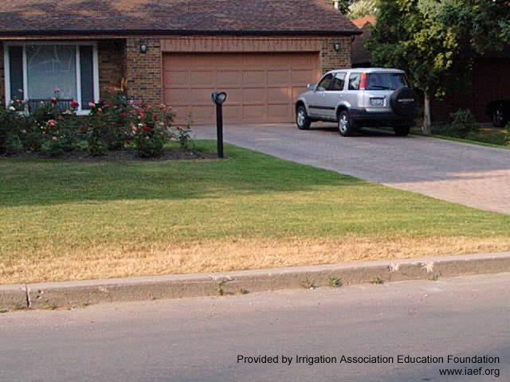
Available Water vs. Readily Available Water
Removal of all soil water could result in quality decline

Slide 21
Readily Available Water (RAW)
RAW = AW * MAD
MAD = Maximum allowable depletion, based on plant type
ө
FC
RAW
AW
PWP

Slide 22
Readily Available Water (RAW) - Example
Assume MAD = 60%
for turfgrass
ө
FC = 3%
RAW = AW * MAD
RAW = ?
AW = 0.48 in.
PWP = 9%

Slide 23
Readily Available Water (RAW) - Example
Assume MAD = 60%
ө
RAW = AW * MAD
FC = 3%
RAW = 0.29 in.
AW = 0.48 in.
RAW = 0.48 in. * 0.6
= 0.29 in.
PWP = 9%

Slide 24
Plant Properties
Irrigation Scheduling

Slide 25
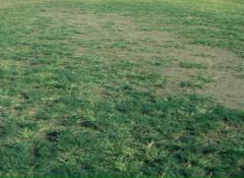
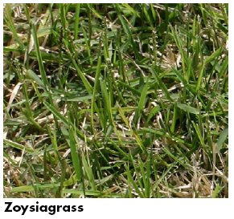
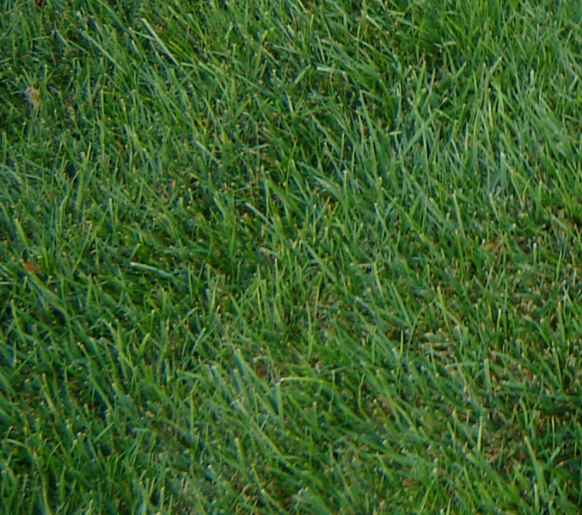
Plant Density
Plant density is an affected by irrigation application and uniformity.
Photo Credits: Melissa Baum Haley

Slide 26
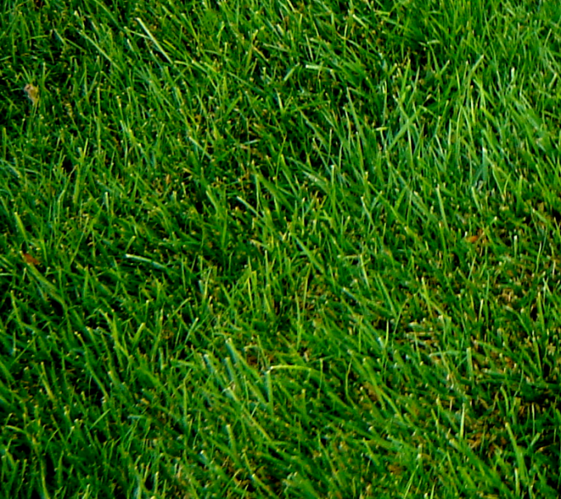

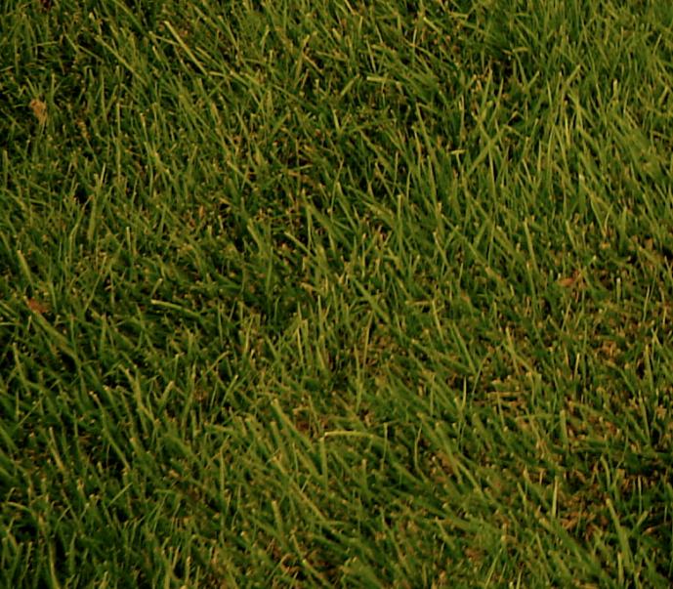
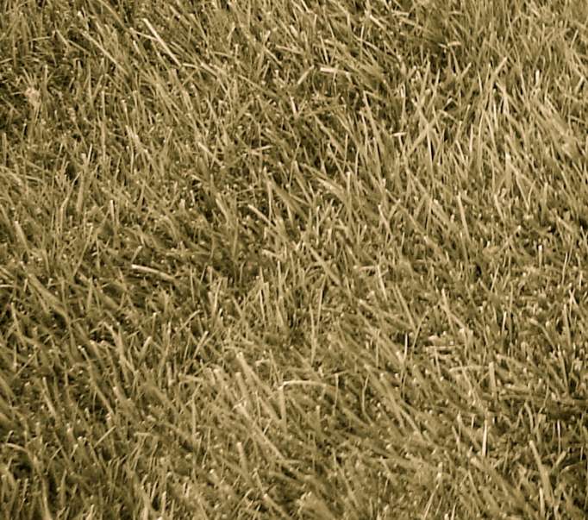
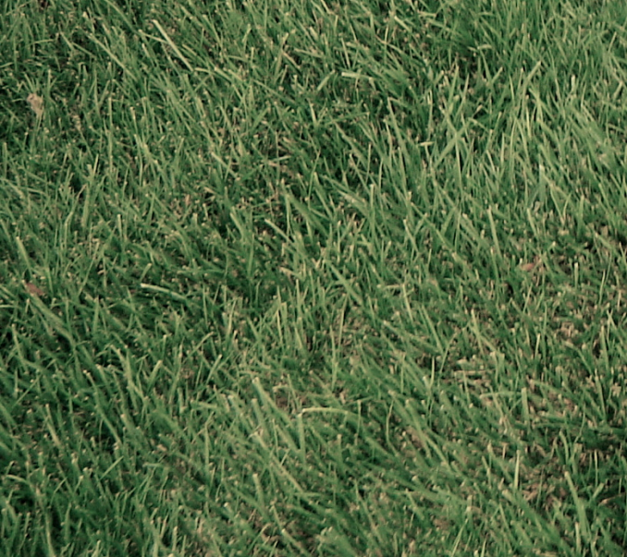
Allowable Stress
Photo Credits: Melissa Baum Haley

Slide 27
When to Irrigate &
How much to Irrigate
Irrigation Scheduling

Slide 28
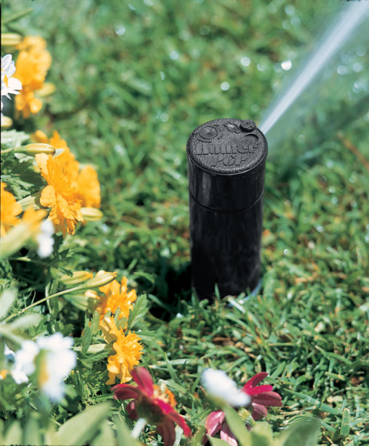
When to Apply
Theoretically refill soil when water content decreases to RAW limit (remember the math)
Other reasons when to apply
  Water restrictions
Drainage (deep percolation) or Runoff will occur due to over application
Photo Credit: IAEF.org

Slide 29

The Checkbook Method
Notes:
Scheduling Spreadsheet Method
Soil water
IF (SWn-1 – ETn-1 + Rain n-1 + Irrig. n-1 < AW) THEN
SWn = SWn-1 – ETn-1 + Rain n-1 + Irrig. n-1 ELSE
SWn = AW
Irrigation
IF (SWn < AW-RAW) THEN
Irrig. n= AW- SWn ELSE
Irrig. n= 0
Gross Irrigation
Gross Irrigation = Net Irrigation/Efficiency
Drainage
IF (SWn – ETn + Rain n + Irrig. n > AW) THEN
Dn = SWn – ETn + Rain n + Irrig. n – AW ELSE
Dn = 0
Effective Rainfall
ERn = Rn – Dn

Slide 30
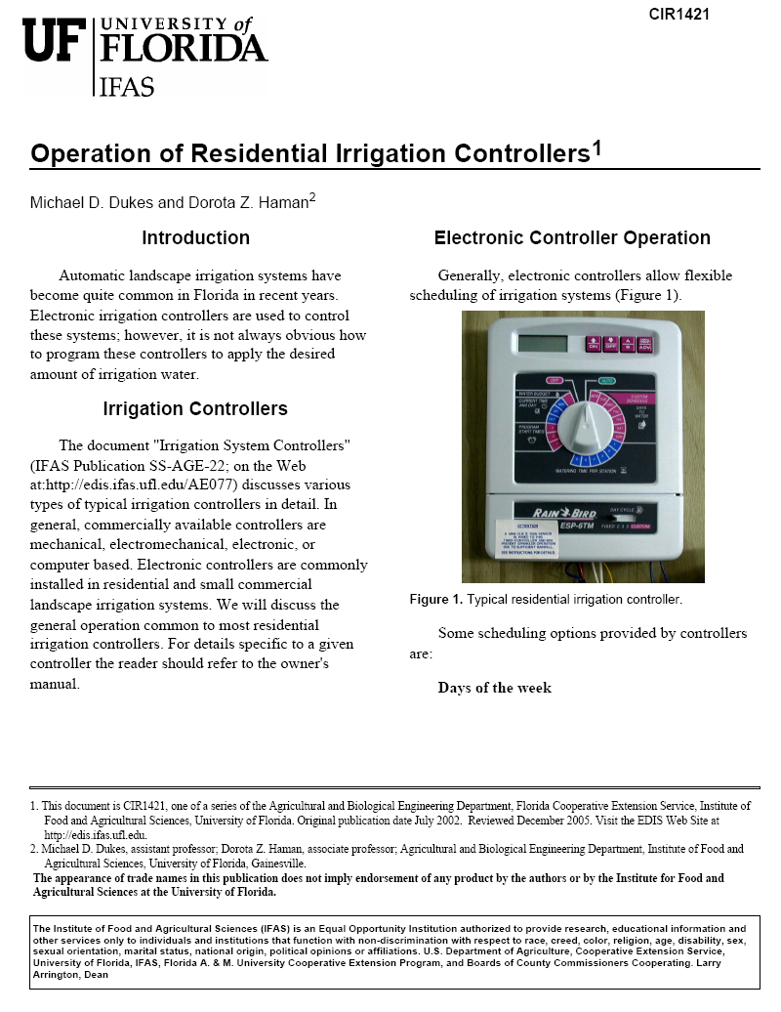
IFAS Scheduling Recommendations
http://edis.ifas.ufl.edu/AE220
Tables give run times for various application rates

Slide 31
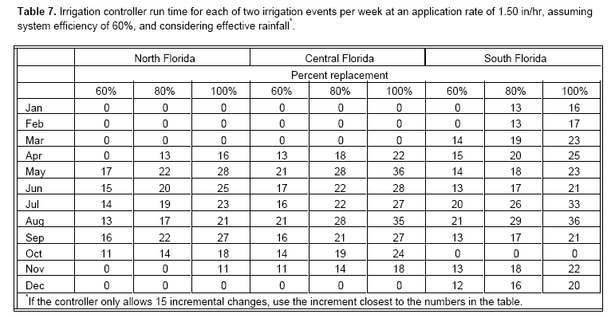
IFAS Irrigation Recommendations - Tables
Notes:
Need to know application rates, I have a slide about this (general rates) should I put that in?

Slide 32
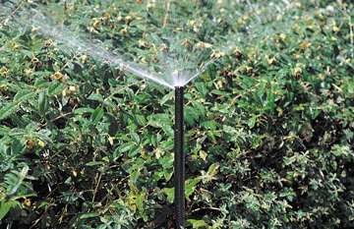
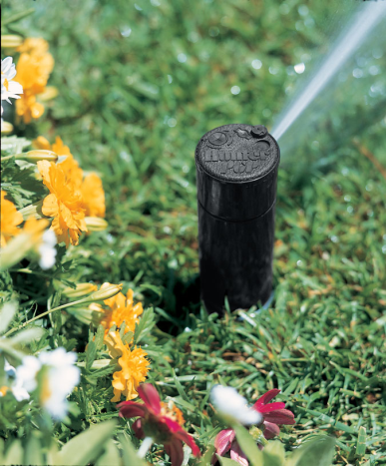
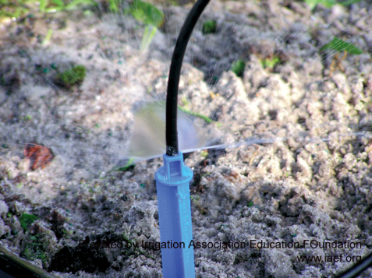
General Application Rates
Spray heads
  1.5 – 8 in/hr
Rotary heads
  0.3 – 2 in/hr
Microirrigation (drip)
  0.3 – 1.6 in/hr*
    * irrigates 50% less area
Photo Credit: IAEF.org
Notes:
Assuming head-2-head

Slide 33
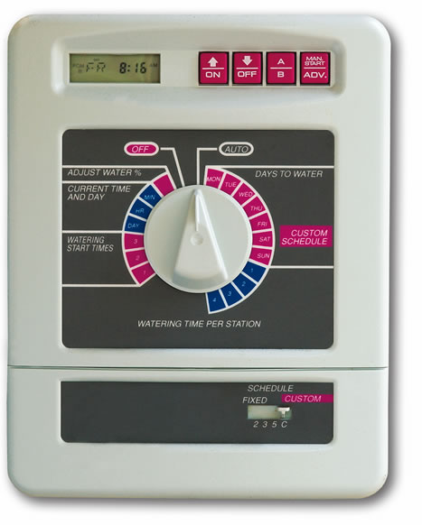
Average Spring/Summer Run Times
(2 times / week)
Spray heads
  15 – 30 minutes
Rotary heads
  35 – 60 minutes
Micro-irrigation (drip)
  35 – 60 minutes
Some controllers allow for multiple programs
Photo Credit: IAEF.org
Notes:
Assuming h-2-h

Slide 34
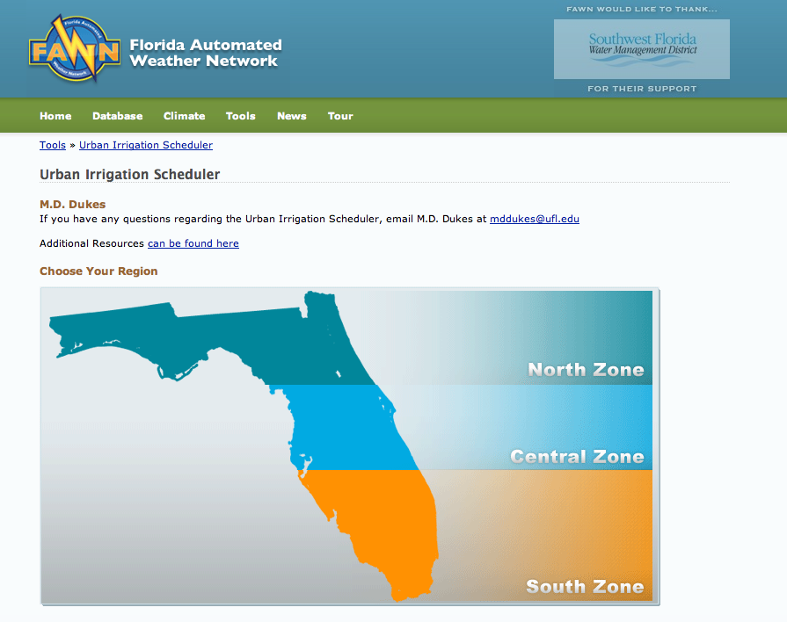
Fawn Urban Irrigation Scheduler

Slide 35
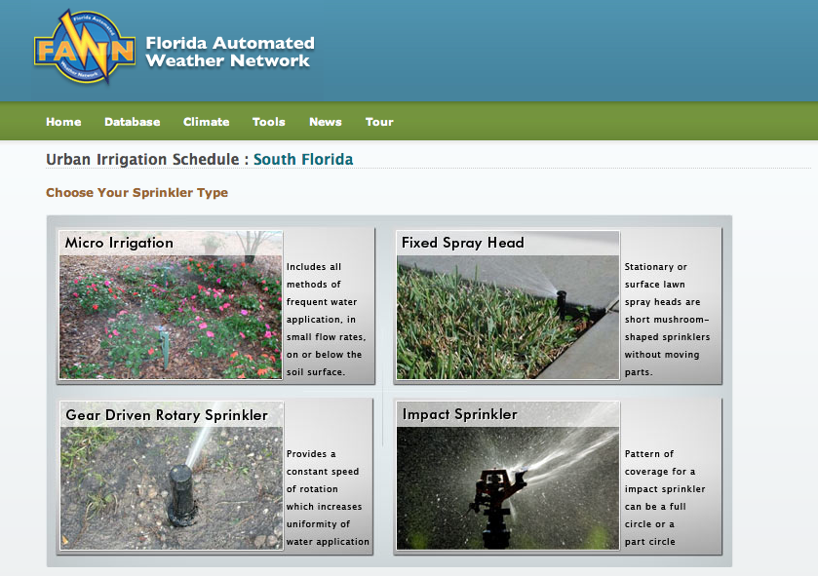

Slide 36
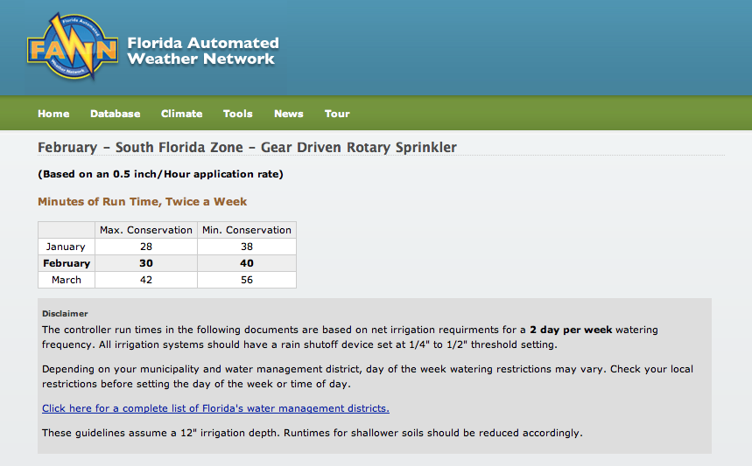
The Urban Scheduler presents 2 day per week run times. For 1 day per week irrigation, increase by 30%.

Slide 37
Water Restrictions
Irrigation Scheduling

Slide 38
When Can I Water?
Watering days are dependant on:
    Water source
    Location – WMD, water purveyor
      House number
Time of Day
Photo Credit: IAEF.org

Slide 39
When can I water?
In many areas watering days differ for irrigation from potable, well, and reclaimed sources.
Reclaimed Water
House # ends in: Then water on:
EVEN number Tuesday, Thursday,
(0, 2, 4, 6, 8) Saturday, and Sunday*
ODD number Monday, Wednesday,
(1, 3, 5, 7, 9) Friday, and Sunday*
Sunday is a watering day for all users
Morning Hours Evening Hours
12:01 AM to 10 AM 4 PM to 11:59 PM
Potable or Well Water
House # ends in: Then water on:
0 or 1 Monday
2 or 3 Tuesday
4 or 5 Wednesday
6 or 7 Thursday
8 or 9 Friday
Morning Hours Evening Hours
12:01 AM to 8 AM 6 PM to 11:59 PM

Slide 40
Deficit Irrigation
Definition: Irrigation water management alternative where the soil in the plant root zone is not refilled to field capacity in all or part of the field
Example: Rather than replace all water lost to ET, irrigate to only replace 70% ET

Slide 41
Scheduling Summary
Scheduling is based on factors such as soil, root zone depth and local weather conditions.
You can determine the appropriate schedule using
  the theory (math)
  utilize many available resources
    Such as the online ‘Urban Irrigation Scheduler’

Slide 42
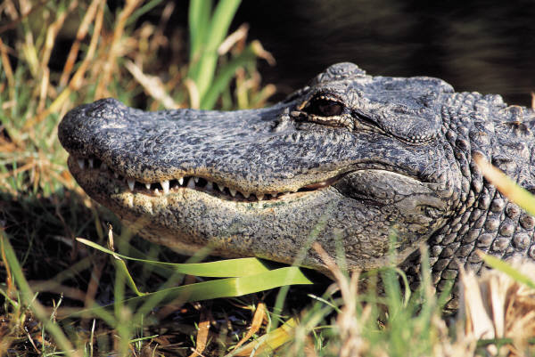
Questions?
Photo credit: Microsoft Clip Art

