Slide 1
Smart Water Application Technologies – SWAT & USEPA Water Sense
Michael D. Dukes, Ph.D., P.E.
Agricultural & Biological Engineering
Institute of Food and Agricultural Sciences (IFAS)‏
Landscape Fundamentals IST
Wimauma, FL, Feb 10, 2009
Notes:
1
Build Green & Profit
1

Slide 2
What is Smart Water Application Technology (SWAT)?
SWAT → Irrigation technologies designed to conserve water
http://www.irrigation.org

Slide 3
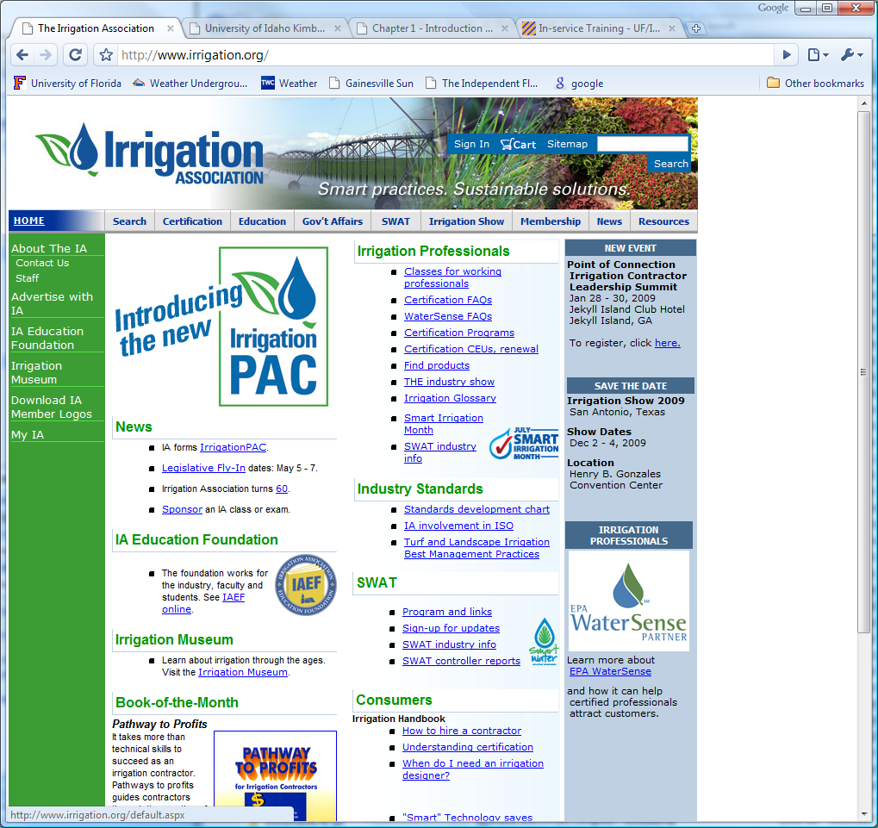

Slide 4
What is Smart Water Application Technology (SWAT)?
SWAT → Irrigation technologies designed to conserve water
http://www.irrigation.org
SWAT concept created approx. 2001 by Irrigation Association (IA) & water purveyors

Slide 6
What is Smart Water Application Technology (SWAT)?
SWAT → Irrigation technologies designed to conserve water
http://www.irrigation.org
SWAT concept created approx. 2001 by Irrigation Association (IA) & water purveyors
Current test protocols
Evapotranspiration (ET) controllers
Soil moisture sensor (SMS) controllers - draft
Rain sensors (RS) - draft

Slide 7
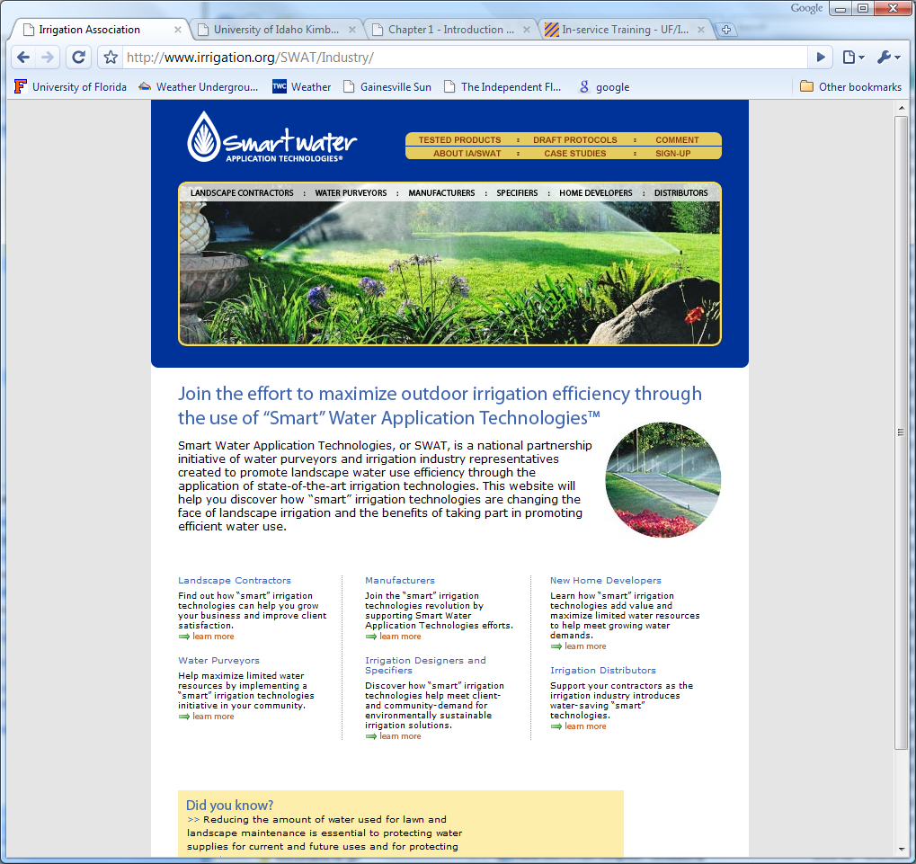

Slide 9
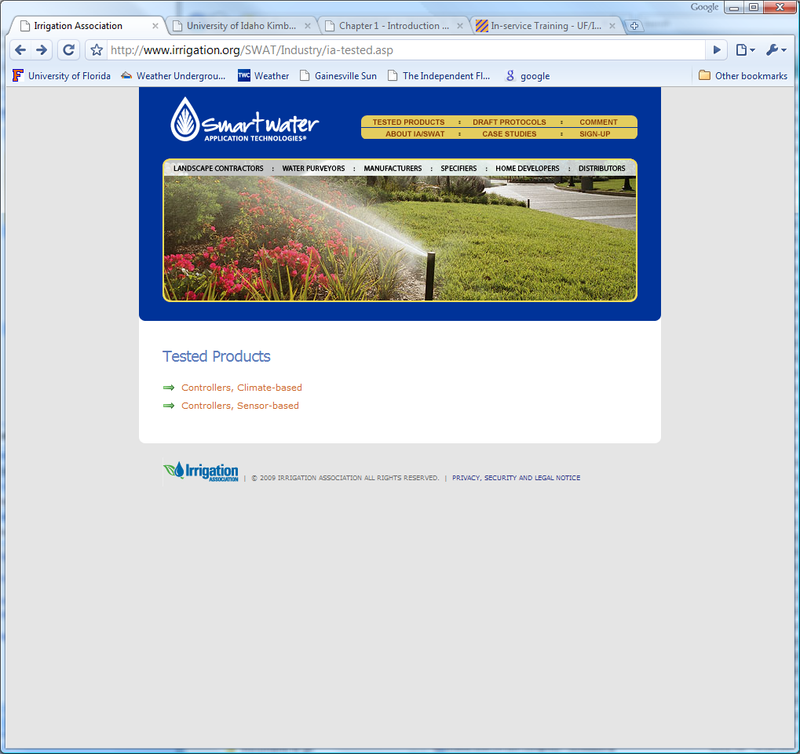

Slide 10
Test Protocols
Virtual controller test around a “hypothetical” landscape
15 ET controllers tested to date
3 Soil moisture sensors (not controllers) tested to date
Rain sensor protocol comments addressed and posted

Slide 11
Water Sense
EPA Water Sense program modeled after Energy Star
http://www.epa.gov/watersense/

Slide 12
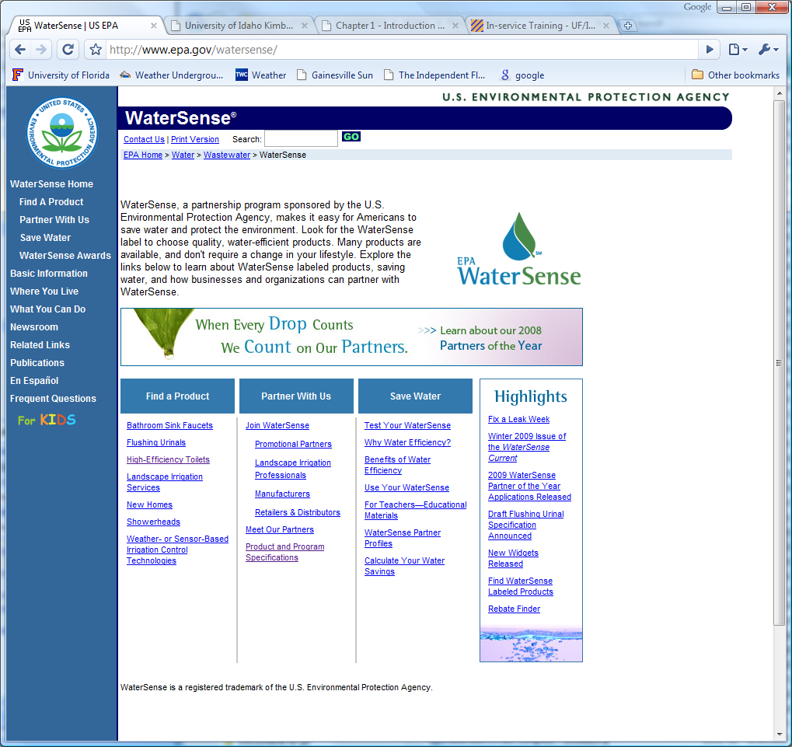

Slide 13
Water Sense Labeled Products
Labels for “water conserving” products
Bathroom sink faucets
Flushing urinals
High efficiency toilets (HET’s)
IA certification programs
Weather or sensor-based irrigation control technologies - DRAFT

Slide 14
Water Sense & Irrigation Controllers
Currently examining SWAT protocol (ET controllers) for adoption
Discussion of testing in two climates (CA & FL??)
Testing funded by manufacturers (<50%) and state funds in CA

