Slide 1

Small Farms Weed Management Strategies
Bob Hochmuth
Multi County Extension Agent
UF/IFAS North Florida REC – Suwannee Valley
Danielle Treadwell
Assistant Professor
UF/IFAS Horticultural Sciences Department

Slide 2
Managing Weeds is One of the Most Difficult Production Issues on Small Vegetable Farms

Slide 3

Managing Weeds – Key Points
100 % control not feasible
Identification important
Especially critical to know perennial weeds (nutsedge, bermudagrass)
Approaches available
  Chemical options
  Fumigation
  Non chemical
Learning bout critical competition times
  Early infestations are bad
Do not allow weeds to go to seed

Slide 4
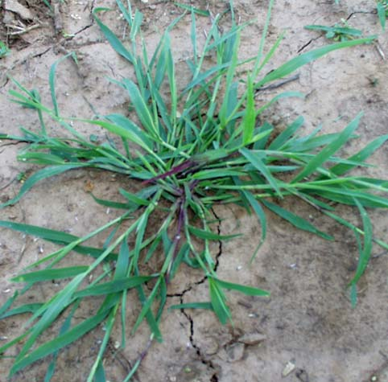
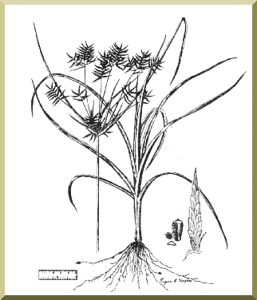
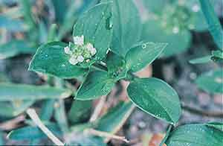
Common Weed Problems
Grasses
  Crabgrass
  Goosegrass
Sedge
  Nutsedge (triangular stem)
Broadleaf
  Florida Pusley
  Purslane
  Pigweed
  Nightshade
Crabgrass
Nutsedge
Florida Pusley

Slide 5
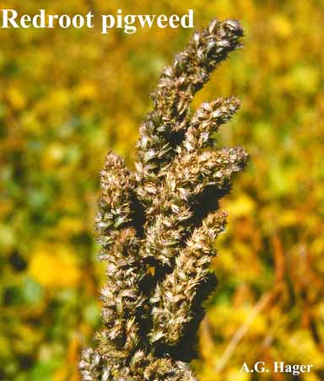
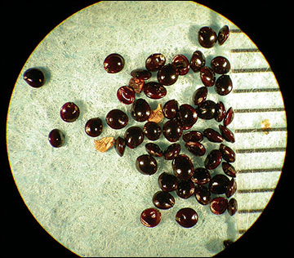
Lower Weed Seed Bank
Prevent weeds from going to seed
Manage weeds in off season
Fully compost animal wastes (pigweed)
  over 1 million pigweed seeds in one pound
Manage field borders and alleys

Slide 6
Rotate Crop Areas
Use bahiagrass areas if possible
Alternate crops with different tillage needs and/or timings.

Slide 7
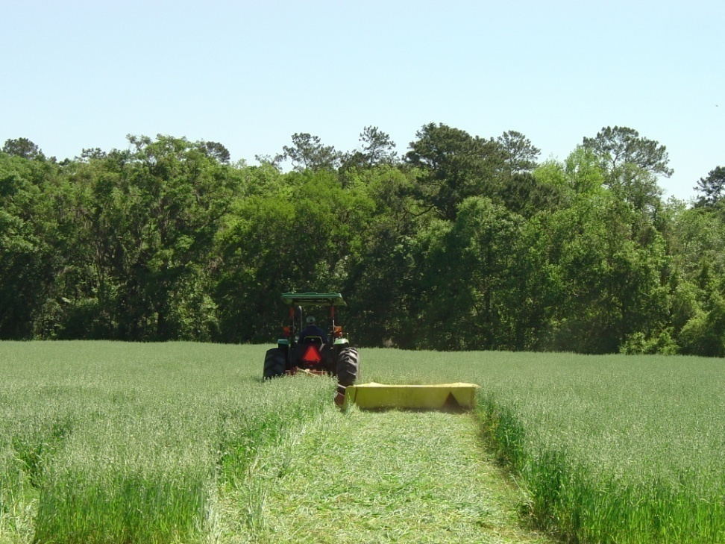
Use Cover Crops
Out compete and shade out weeds
Winter – rye or oats
Summer – millet, sorghum-sudan grass
Seed cover crops at high rates
Irrigate to quickly establish covers

Slide 8
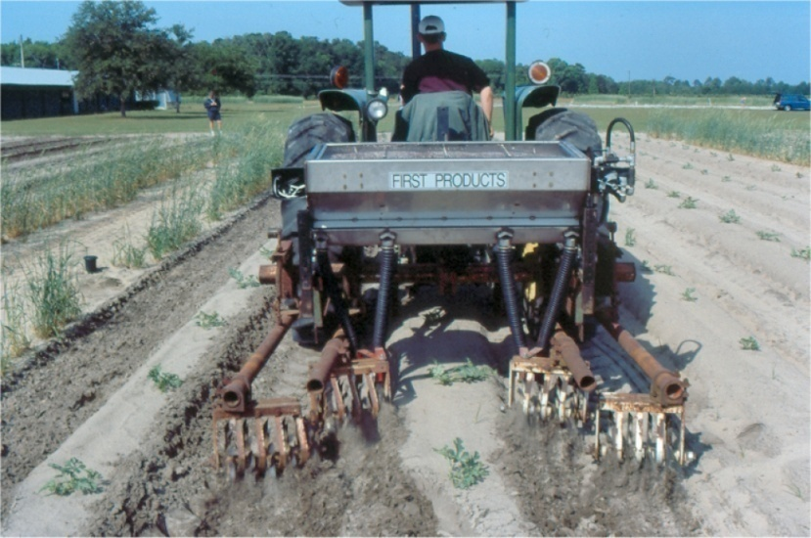
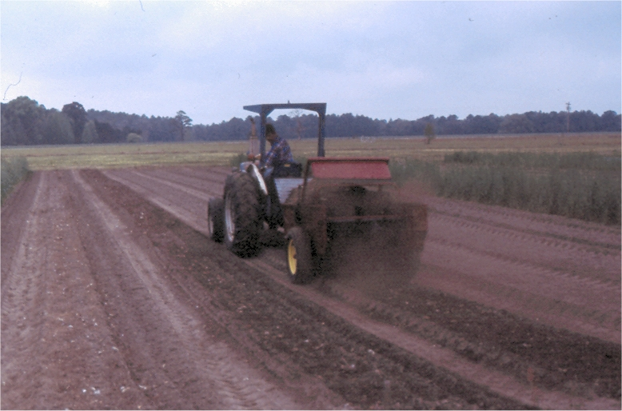
Feed Crops, Not Weeds
Avoid broadcast preplant applications if possible, especially nitrogen
Apply near rows or on beds and not alleys
Sidedress N & K
Use drip irrigation for water and fertilizer applications

Slide 9
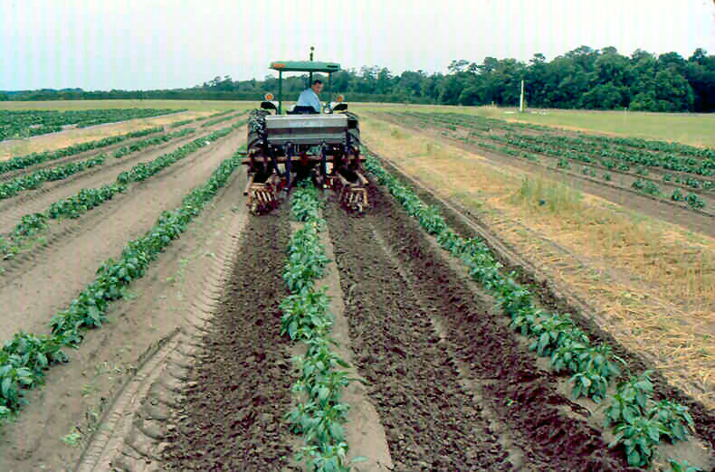
Cultivation Methods
Shallow cultivations
Rolling cultivators
Spider wheels
Basket style weeders
Shallow sweeps
Hot part of day
Dry row middles
Catch weeds when small (white tread roots)
Uproot and bury when small

Slide 10
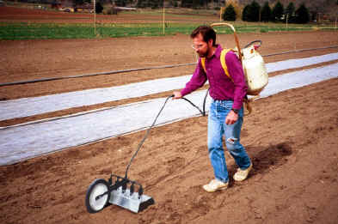
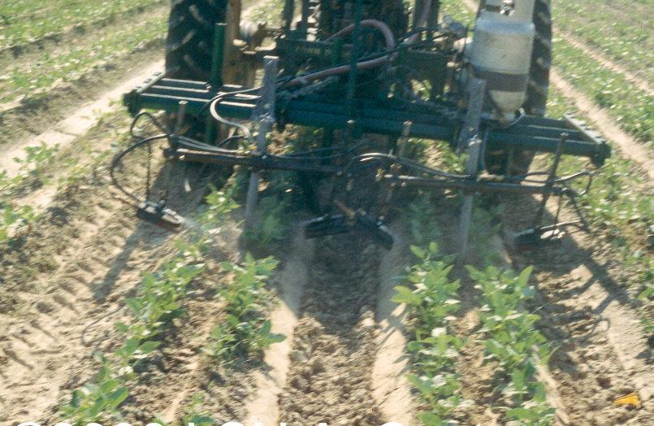
Flame Weeders
Broadcast after final prep and before seeding
Single burners between rows

Slide 11
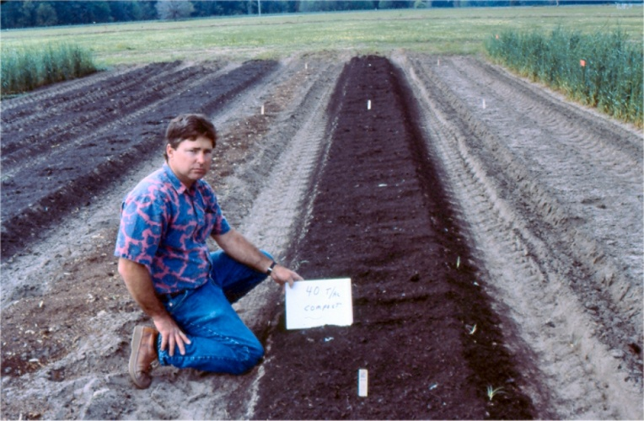
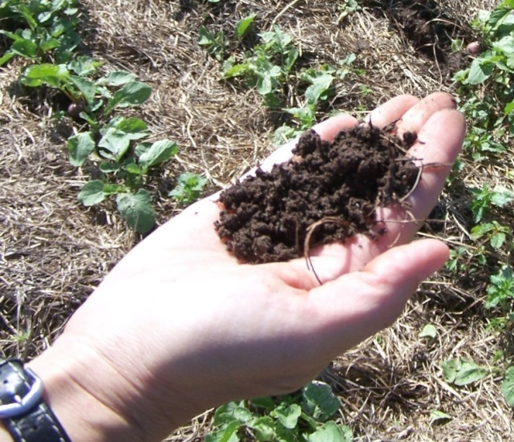
Plant Mulches
Straws
Composts
Bark mulches
Composted yard waste
Hay – Careful!!
Minimum 2-4 inches

Slide 12
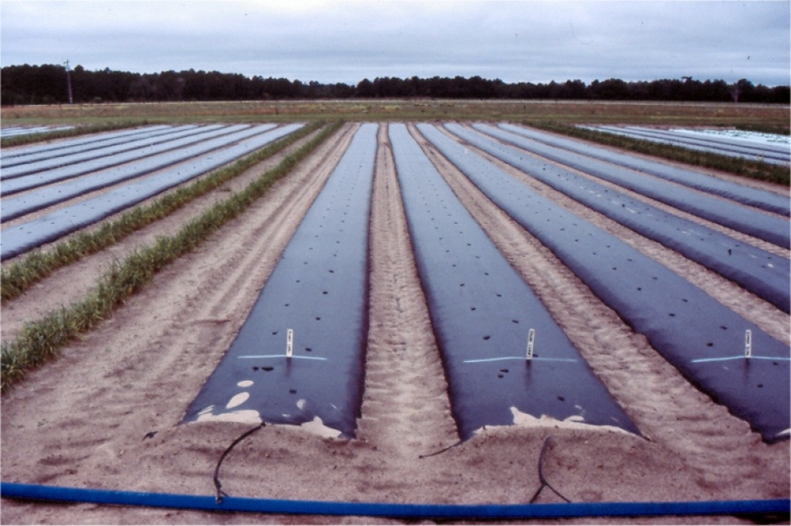
Plastic Mulches
Black mulch
  Warms soil
  No light for weeds
  Sedge can poke through
Black layer if other color used
  White-on-black
Multiple cropping
Focus on row middles

Slide 13
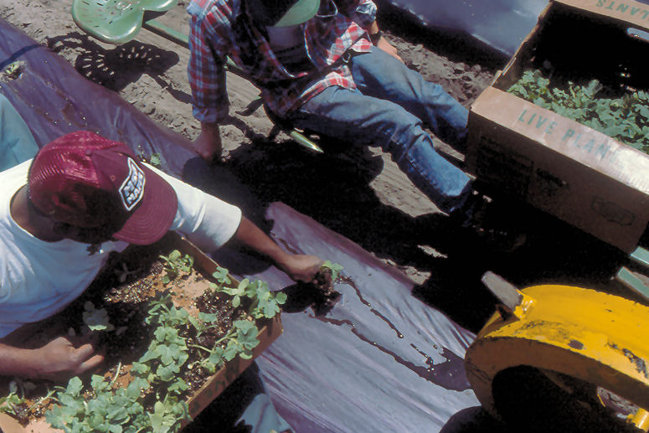
Transplants
Use transplants when possible
  4 to 6 weeks old
  Head start to compete
  Shorter season in field
  Can use mulches easily
    straw
    composts
    composted yard waste

Slide 14
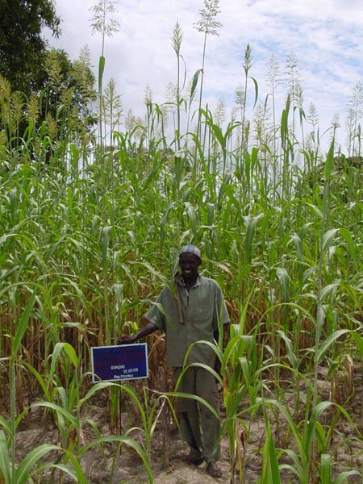
Allelopathy
(Def.) Production of a plant compound that has an indirect effect and either inhibits or stimulates another organism’s growth.
Compounds are leached, volatilized, exuded, or released following mechanical destruction of plant.
Notes:
Sorgolene is found in the root exudates of most sorghum species and has been shown to be a very potent allelotoxin that disrupts mitochondrial functions and inhibits photosynthesis.
Variety selection – transplants, fast germinator, bush type or vining (beans), trellis
Intercropping – several crops can supress weeds that grow near them (Worsham, 1989) including beets, lupine, corn, wheat, oats, peas buckwheat, millet, barley, rye and cucumber. Due to allelopathy

Slide 15
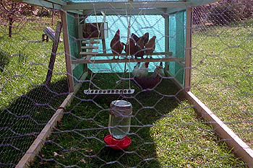
Predation
Poultry – “Chicken tractor”
Birds
Microrganisms
Insects
Notes:
Plastic – weed propagules die, also germinated weeds (heat). Also, under plastic, atmospheric gases o2 and co2 accumulate, and imbalance detrimental. Ethylene and acetylaldehyde also present. Moisture necessary to ensure thermal sensitivity of weeds, improve heat conduction, and ensure biological activity during solarization. Duration and type of plastic important. Typically, weeds die only in top 4-5 inches. Duration 3-10 weeks. Summer best.
Heat – soil solarization preplant, 122 degrees with thermal infrared retentive films (TIR) + kills nutsedge (Chase, weed sci, 1999)

Slide 16
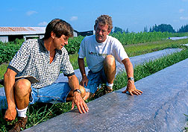
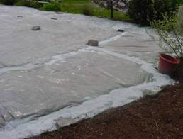
Soil Solarization
Raises soil temperature to kill weeds (and more)
Excellent for shallow weeds
Fair on root knot nematodes
Beds or tarp
Time of year critical
  Summer months (Jul-Aug)
Length of time = at least 4-6 weeks, longer best
Soil temps
  120° F = top 2 inches
  115° F = 2 to 4 inches
  105° F = 4 to 6 inches
Complications with nutsedge

Slide 17
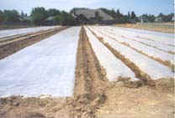
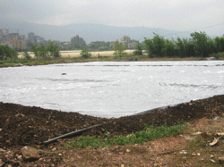
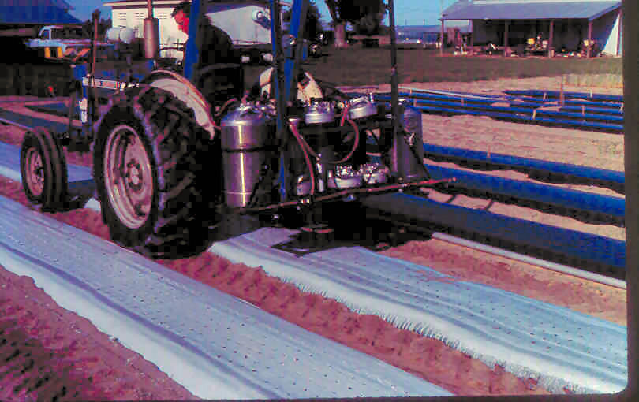
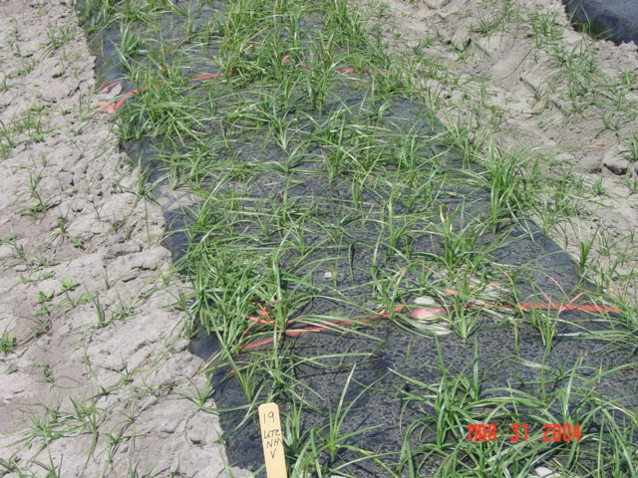
Solarization Strategies
Large tarp
Individual beds
Complication of Nutsedge
Paint before planting

Slide 18
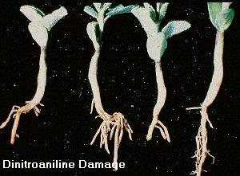
Chemical Weed Control
Very difficult in diversified vegetable operations
Rotations need to be considered
Treflan (trifluralin)
  beans, southern peas
  cole crops
  greens
  tomato
Not for vine crops, sweet corn
Poast, Select, Fusilaide – selective for grasses
Glyphosate (Roundup) between crops

Slide 19
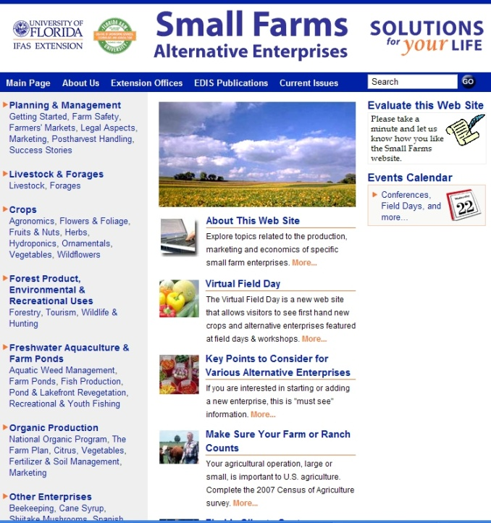
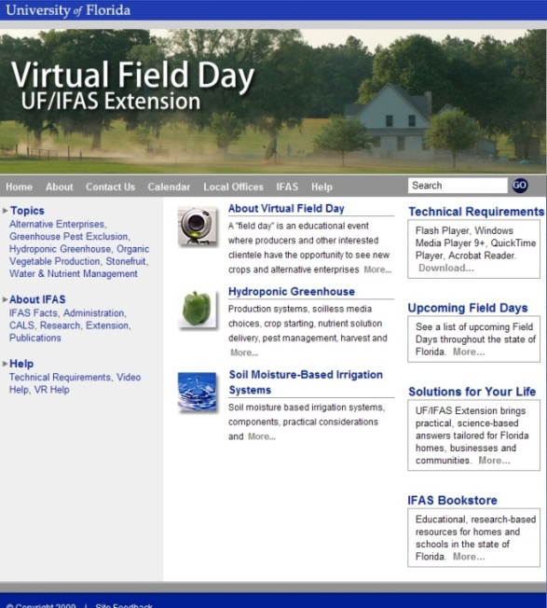
Thank You
For more information visit the Small Farms web at http://smallfarms.ifas.ufl.edu
Take a virtual field day tour by visiting the Virtual Field Day web at http://vfd.ifas.ufl.edu
This presentation brought to you by the
Small Farms/Alternative Enterprises Focus Team.

