Slide 1
Starting a Vineyard in Central Florida
Ryan Atwood
Extension Agent
Multi County Fruit Crops

Slide 2
Why grow grapes?
Growing wine industry in the state
Established industry- Buyer present in area
Florida Department of Agriculture and Consumer Services Commercial Vineyard Increase Acreage Grant Program (IAP)
Notes:
L

Slide 4
Lakeridge Winery
Been in business since 1989
Largest producer and user of grapes in Lake Co. and Central Florida
Business is growing 20% annually
Soon to sign with a distributor – increasing market
Owns two winery locations St. Augustine & Clermont; landlocked in St. Augustine expanse to occur at Clermont location

Slide 5
FDACS – Increase Acreage Program (IAP)
Florida Viticulture Policy Act (Ch 599FS) calls for the expansion and growth of into a broad-based economically viable industry.
Establishes a trust fund derived from taxes on Florida produced wine sales.
Florida wineries and fresh fruit sellers are unable to purchase all their grapes for Florida grape growers

Slide 6
IAP - What is a Commercial Vineyard and Who is Eligible?
Any grower that owns 20 contiguous acres of Florida land that is suitable for vineyards that already produces grapes or shows they have agricultural experience
Applicant must propose sufficient planting to achieve a minimum of 5 vineyard acres (existing plus proposed).
Must include a contract or letter of commitment from a purchaser of grapes or U-Pick marketing plan.

Slide 7
IAP- How much will the Increased Acreage Grant Fund?
Projects may be granted an amount not to exceed $1,000 per acre to assist in expanding a vineyard.
Can be used for reimburse direct project costs, such as materials, supplies, and labor.
Applications are due September 1st of each year with funding available the following March 15th.

Slide 8
IAP - Repayment
Vineyard must be completed within one year of approval
Once installation is complete a notification letter should be sent and site visit will coordinated.
Once delivery of grapes occurs (in third year) grant shall be deemed repaid. If vineyard is abandoned or fails to produce marketable crop within 5 years, all grant funds shall be repaid.

Slide 9
Cost and Returns
Establishment Costs between $5,000-$7,000 acre
Full production at 5-6 years
6-8 Tons/acre in Lake Co.
$550 Price/Ton

Slide 10
Cost and Returns
Production costs $1,700-$2,500 per acre per year
Profitable after year 4; break even after 7-12 years
Internal Rate of Return (IRR) varies between 8% to 30% depending on what numbers you use.

Slide 11
Establishing a Vineyard Pre-Planning
Site selection
Cultivars
Arrangement and Pollination
Nursery and Care of Plants
Row Orientation and Length

Slide 12
Site selection
Produce best in full sun with fertile, well drained soils
Can be grown on our sandy ridge soils with timely irrigation and fertilization
Sites with elevation and good cold drainage are preferred so as to avoid cold damage.

Slide 13
Cultivars
Depends on if you are making wine, jelly, selling to the fresh market or U-pick as to which cultivar maybe appropriate
Noble, Carlos, and Welder is what the local winery is buying
Southern Home, Fry, Black Fry, many others recommended by IFAS for Fresh market

Slide 14
Cultivars - wine, jellies, and juice
Must consistently have high yields
Should have a Brix of 14, good sugar to acid ratio
Berry ripening should be uniform to avoid multiple harvest
Appearance is not critical

Slide 15
Cultivars - Fresh market
Should be large, sweet, attractive with relatively thin skin
Have good vine vigor and disease resistance
Many are female cultivars with imperfect flowers so they require a pollenizer

Slide 16
Nurseries
Shortage of nurseries growing vines in the state
Some cultivars difficult to get
Vines cost around $4.00 a plant
Bare-root or containerized
Available list of nurseries on the Florida Grape Grower associations webpage www.fgga.org

Slide 17
Row Orientation and Length
North-South row orientation are best in fruit crops as they allow for direct sunlight on both sides of the plant
Row length of a 600 feet maximum
Shorter rows will limit any lightening damage that occurs

Slide 19
Vineyard Design
Set post and secure wire prior to planting
Plant spacing is dependent on design but typically 12-20 feet within row and 10-15 between rows
Plant vines within one to three feet of posts to minimize wire sagging

Slide 20
Vineyard Production Practices
Training to trellis
Pruning
Fertilization
Irrigation
Weeds
Diseases
Harvesting

Slide 21
Training to Trellis
Normally 3 or more shoots will form out of a seedling, select the strongest and straightest
Support with a stake and/or string attached to the wire
Once it reaches wire prune tip to promote two lateral buds

Slide 22
Pruning
Prune vine to maximize performance
Mid-January to Mid-March activity

Slide 23
Fertilization
Prior to planting determine soil pH (5.5-6.5) and nutrient status
In first growing season fertilize in April, June, and August using ¼ lb of 10-10-10 in a one foot band on each side of vine
Second year use 1 lb per vine and subsequent years use 3 lbs per vine

Slide 24
Irrigation
Drip irrigation most effective
Essential during the first year 2 gallon/hour emitter ~ 1 ft from vine
Subsequent years two emitters spaced 3 feet from vine (4 gallon/hour emitter)

Slide 25
Irrigation
Most critical time for optimum fruit set is May thru June; after that sufficient rains
Limited irrigation in August and September for sugar accumulation and berry ripening

Slide 26
Weeds
In Florida, weed control is critical for vineyard operations and optimal vine growth
Muscadines are shallow rooted, no deep cultivation! It can injure root systems

Slide 27
Diseases
Many cultivars can be grown with no pesticide use
Angular leaf spot, Bitter rot, Black rot, Powder mildew, and ripe rot can be problematic
Fresh market requires blemish free berries thus the use of fungicides

Slide 28
Harvesting
Season starts for some cultivars as early as late July extending to late September
Hand harvesting is expensive and hot!
Mechanical harvesting is the preferred method for wine grapes
Shake berries onto a tarp
Shelf life is limited; most fresh market cultivars one week when refrigerated

Slide 29
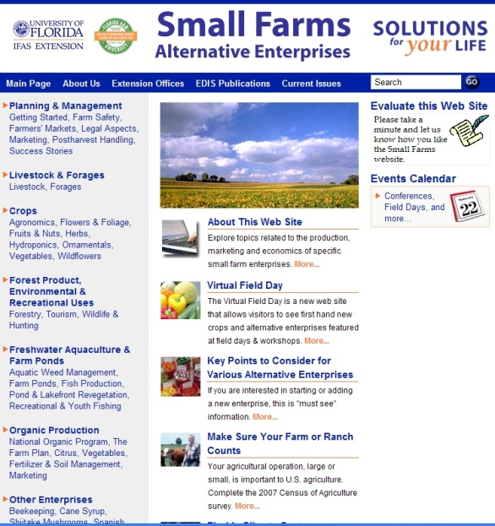
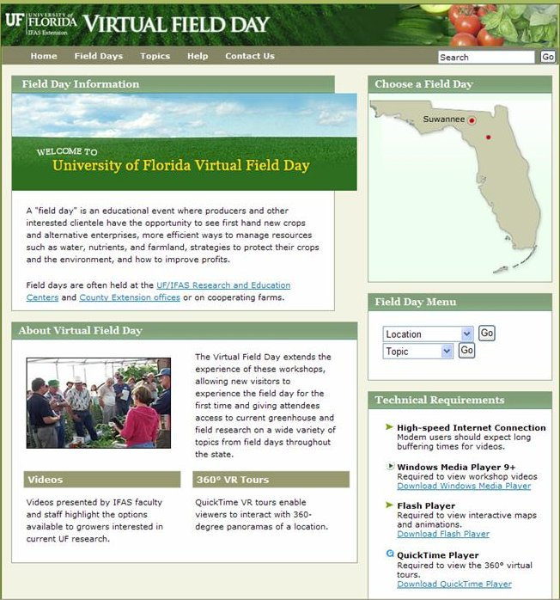
Thank You
For more information visit the Small Farms web at http://smallfarms.ifas.ufl.edu
Take a virtual field day tour by visiting the Virtual Field Day web at http://vfd.ifas.ufl.edu
This presentation brought to you by the
Small Farms/Alternative Enterprises Focus Team.

