Slide 1
Successful Heirloom Vegetable Production
Dr. Danielle Treadwell
UF-IFAS Horticultural Sciences
&
Dr. Aparna Gazula
UF-IFAS Alachua County Extension
Notes:
J. Jordan. 2007. The heirloom as cultural object: Investigating taste and space. Sociologia Ruralis, Vol 47, Number 1, January 2007
The emergence of the heirloom tomato appears to resemble that of other cultural
objects, where the efforts of the actors engaged in it combine with broader cultural
shifts (DeNora 1991; Wagner-Pacifici and Schwartz 1991; Fine 1995; Ferguson 1998;
Zolberg 1998). In this case, seedsavers and chefs figure centrally in the cultivation of
the tomatoes themselves and also the cultivation of a taste for them. In addition,
interest in local and organic food, including arguments about biodiversity
and significant increases in the number of farmers’ markets, emerges in part
in response to the increase in industrial agricultural production, including the
increase in genetically modified organisms (GMOs) and the perceived decrease
in the flavour and variety of mass-produced and distributed food. But the close
examination of heirloom tomatoes presented here also reveals an unexpected trajectory
– namely, the centrality of space in understanding and investigating distinction.

Slide 2
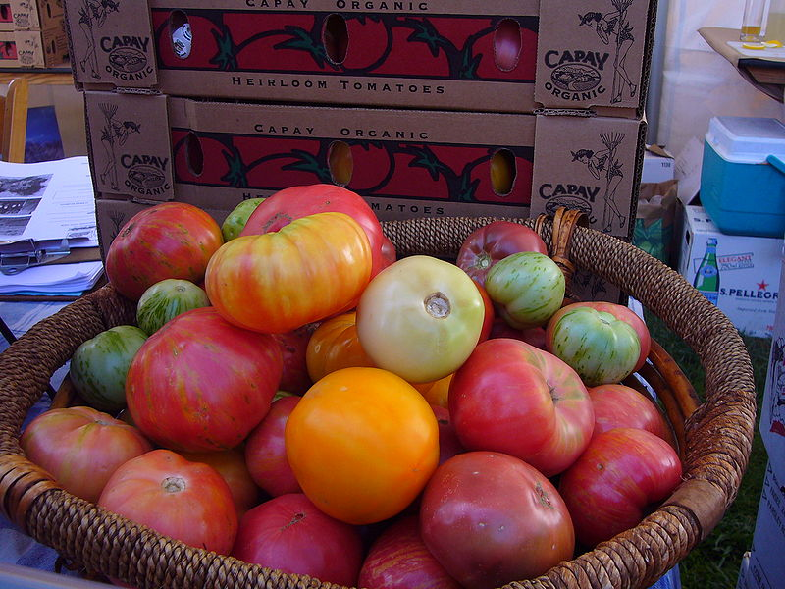
What is an Heirloom?
Always open pollinated, never hybrids
An “old variety”
Must have a history of its own

Slide 3
Heirlooms Are Open Pollinated
Open Pollinated varieties:
Have seeds that breed true (F₁ = F₂ = F₃)
Are traditional varieties that have been selected for desirable traits over a long time
Are often suitable for low-input production systems
Can adapt to local ecosystems over generations
Have little commercial incentive to produce new open pollinated varieties

Slide 4
Heirlooms Are Not Hybrids
Hybrids varieties:
F₁ (first generation) offspring of two different but compatible parents
Typically do not breed true, over time they will revert to characteristics of the parents
Are often selected for shipping qualities
Typical in high-input, commercial horticulture

Slide 5
Heirlooms are Old
How old is old? Here are some opinions:
In production before 1950 (availability of hybrid seeds)
In production during the WWII Victory Gardens 1940’s
Traditional Native American crops (over 200 yrs old)
Old European crops (400 yrs old)
Should varieties be excluded from Heirloom classification just because they were commercially successful?
Notes:
Google search for:
“heirloom” = 4,540,000 pages
“heirloom tomatoes” = 604,000 pages
“heirloom vegetables” = 207,000 pages
“heirloom sweet corn” = 121,000 pages
“heirloom bell peppers” = 105,000 pages
Seed Saver’s Exchange is a non-profit organization founded in 1975 dedicated to the preservation and distribution of heirloom seeds. Since Oct 2008, their membership grew from 8,000 to over 11,000 members. Their annual 2009 budget was $4 million.

Slide 6
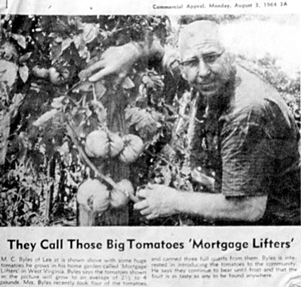
Heirlooms Have History
The tomato cultivar ‘Mortgage Lifter’ was developed in the 1930’s by “Radiator Charlie” Byles by crossing a variety of tomato cultivars with a German Johnson until he was happy.
He sold the plants for $1.00 each, and paid off his mortgage.
From Living on Earth: www.loe.org
Notes:
http://www.loe.org/shows/segments.htm?programID=05-P13-00038&segmentID=8

Slide 7
Heirlooms are Popular
J. Jordan. 2007.

Slide 8
What You Should Know About Heirlooms
Require trial and error to produce consistent quality and yield
Select varieties suited for our area
Quirky growing characteristics
Many varieties lack modern-day disease resistance
Many varieties are indeterminate, and may have poor canopy cover
Subject to physiological disorders
Variable shape and soft skin make pack-out difficult
Best for direct markets

Slide 9
A successful system starts with a buyer!
Consumers LOVE heirlooms because they taste good and are beautiful to look at.
Know what you can sell before you plant.
Consumer education is very important – identify those with specific cooking and eating qualities in your marketing.
Notes:
No matter what your definition…..

Slide 10
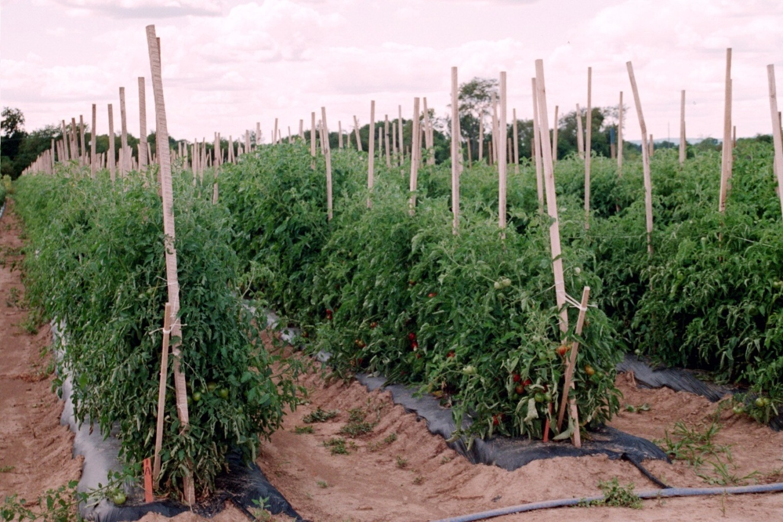
Field Production
Notes:
Heat and high humidity facilitate the onset of disease.
Lack of resistance exacerbates the problem, necessitating a number of preventative and curative sprays
For these reasons, drip irrigation is preferred vs. overhead.

Slide 11
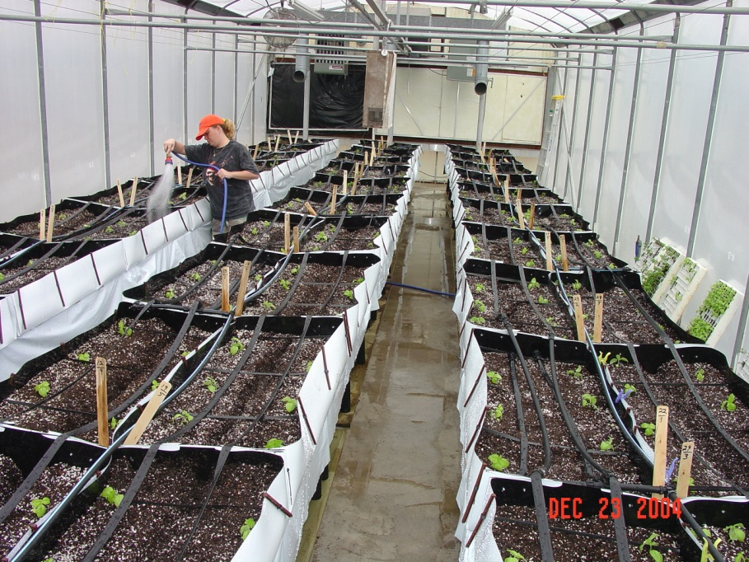
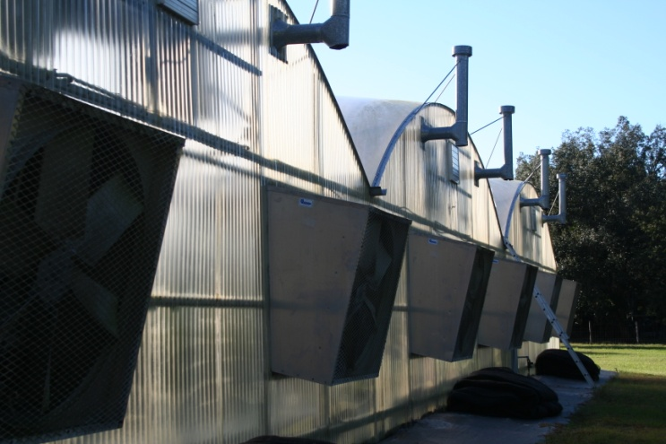
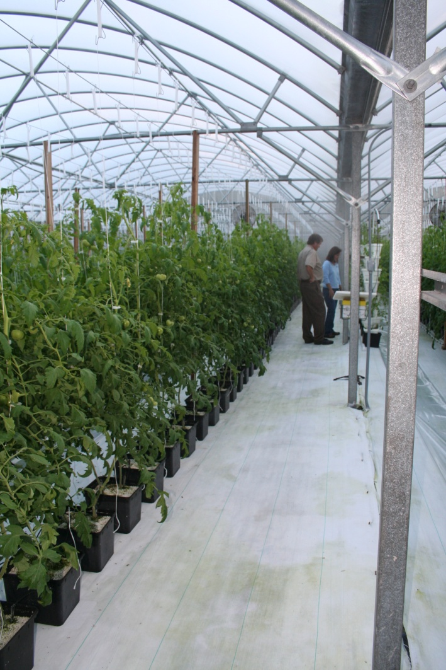
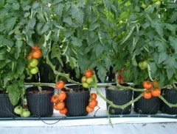
Greenhouses
Notes:
Examples of Florida greenhouse systems.

Slide 12
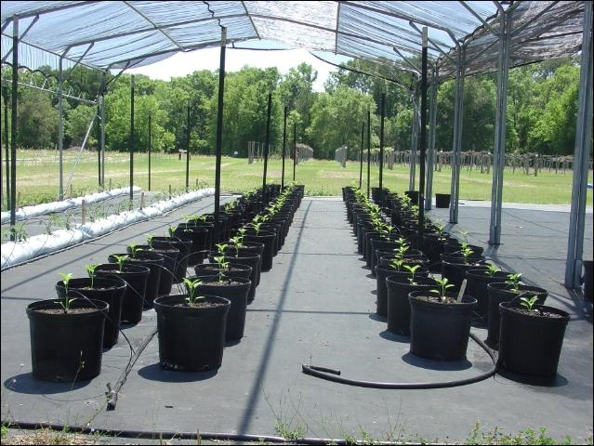
Shade Houses
Notes:
Protected culture of heirloom tomatoes is one strategy used to reduce the negative effects of the inherent genetic characteristics of heirloom cultivars as well as mitigate the effects of Florida’s hot and humid climate on fruit quality and yield.
The use of sterile media also assists in the prevention of disease, as does the landscape fabric (preventing splashing)

Slide 13
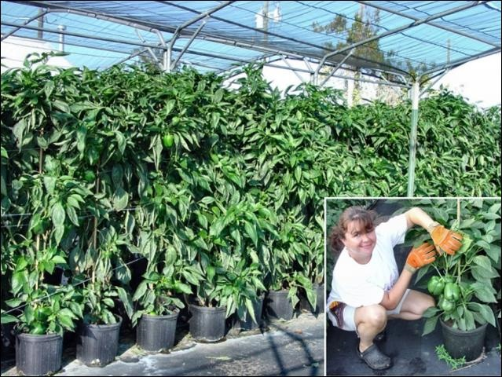
Shade Houses
Notes:
Shown is Wanda Laughlin, NFREC-Suwannee Valley in Live Oak, FL.

Slide 14
High Tunnels
Notes:
High tunnels producing heirloom tomatoes at NC State University’s research farm The Center for Environmental Farming Systems in Goldsboro, NC.

Slide 15
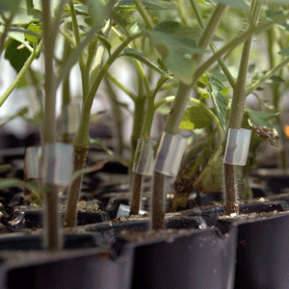
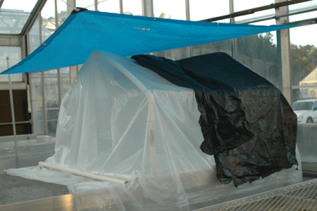
Grafting
Grafting provides site-specific management tool for soilborne disease
Bacterial Wilt (Ralstonia solanacearum)
Fusarium Wilt (Fusarium oxysporum f.sp. lycopersici)
Root-knot Nematodes (Meloidogyne spp.)
Verticillium Wilt (Vertcillium dahliae (race 2))
Southern Stem Blight (Sclerotium rolfsii)
Rivard and Louws, NCSU
Notes:
The hydroponic production of heirloom tomato types differs somewhat from the standard greenhouse hybrids. Because these older varieties are more prone to serious disease pathogens which can severely limit production, preventative measures should be taken where ever possible. One of these is the use of rootstocks which can prevent an outbreak from the array of diseases that older varieties may develop. Grafting the heirloom variety onto a disease resistant root stock gives the plant the ability to resist certain root diseases, but also improve yield potential as most root stocks provide the plant with a healthier and more vigorous root system. This system of grafting allows the production of heirloom fruit, while utilizing modern plant breeding for disease resistance via the root stock. One study found that grafting heirloom tomatoes onto the resistant tomato rootstocks GRA 66 and Hawaii 7996, did not wilt under high soil disease pressure from bacterial wilt and produced significantly higher harvestable yields (Rivard and Louws 2006). The rootstock Maxifort has also found to enhance plant vigor and yields when used with heirloom varieties. Where bacterial wilt might be a problem, heirloom types can be grafted onto suitable, resistant eggplant root stocks. Other root stock varieties with resistance to fusarium wilt, bacterial wilt, verticillium and TMV - as well as the ability to increase plant vigor - are a good way of increasing disease resistance in heirloom varieties which would otherwise be highly susceptible.

Slide 16
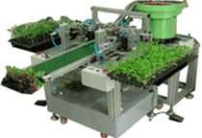
Grafting
~25 days early season extension with high tunnels.
Total productivity was higher in the tunnel system.
Beaufort and Maxifort show higher yields under no soilborne
Disease pressure.
Rivard and Louws, NCSU
Notes:
81% Korean and 54% of Japanese vegetable production uses grafted plants (Lee, 2003)

Slide 17
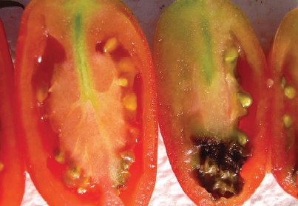
Physiological Disorders
Catfacing
Zippering
Blossom End Rot
Sun scald

Slide 18
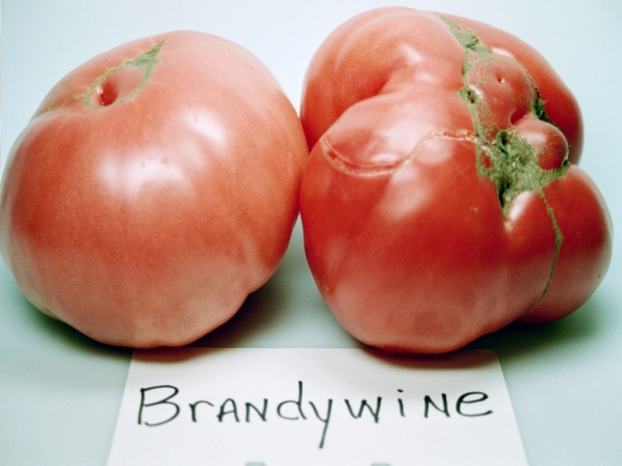
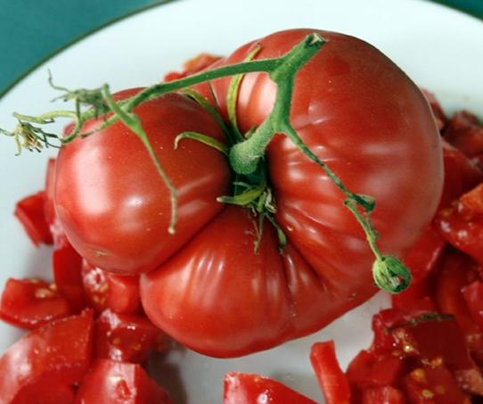
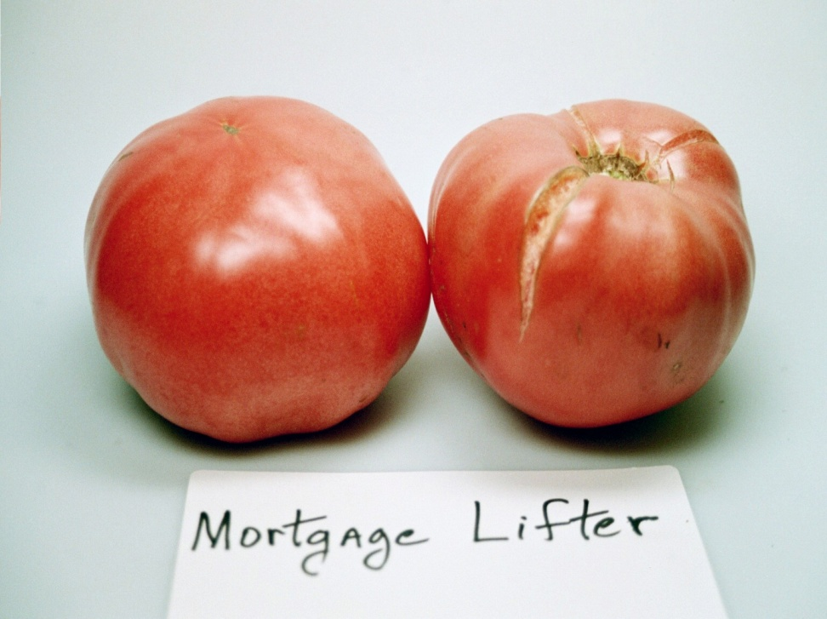
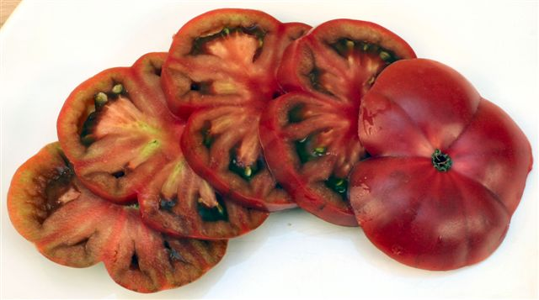
Tomato
Black Krim
Notes:
Treadwell et al 2007. There are several production constraints to large scale commercial adoption of heirloom tomatoes. Heirloom tomatoes have a tendency to crack at the stem end and create openings in the epidermis. The cracks surrounding the stem scar provide an entry for plant pathogens that in turn reduce quality and shelf life. Further, enteric pathogenic bacteria have been documented to enter cracks and reside in fruit for several weeks and thus pose a risk to food safety (Orozco et al., 2007). Heirloom cultivars tend to lack resistance to nematodes, insects and disease, and therefore require more management, labor, and inputs. Physiological diseases such as zippering, caused when anthers attach to the ovary wall of newly forming fruit and cat-facing, caused by a combination of abiotic factors including cool weather, pruning and high nitrogen (N), reduce aesthetic quality and market grade of affected fruit. Many cultivars are indeterminate and require tall stakes for support or frequent pruning to limit vertical growth. Leaf cover is highly variable among cultivars, and when coverage is poor, high light intensity can lead to sunscald. Finally, their variable fruit shape and soft flesh interfere with a consistent pack out.
http://www.growingedge.com/magazine/current_issue/view_article.php3?AID=200334 Another major drawback with most heirloom varieties is the presence of physiological disorders which downgrade the fruit quality and appearance. Many are prone to radial cracking, crazing or splitting due to the thin skin and lack of tolerance to many environmental conditions. Some consistently produce misshapen fruit caused by cat facing, while others are prone to fruitlet drop or blossom end rot. Many small scale producers accept that a high 'pack-out' rate will occur with many heirloom varieties and channel second-grade fruit into value added, processed products such as sauces and preserves.

Slide 19
Tomato
Large, red slicers are in demand
Cherries, grapes require additional time and labor to harvest
Varieties grown in Florida include:
Brown Betty (brown cherry)
Mortgage Lifter (giant red slicer)
German Johnson (red slicer)
Amish Paste (red-orange elongated)
Striped Roman (red w/yellow stripes plum)
Notes:
Yield variability is perhaps the greatest disadvantage with heirloom tomatoes and growers can manage this problem by carefully assessing a wide range of heirloom cultivars to determine which has the yield and fruit characteristics most profitable. Various studies have been published which evaluate a number of heirloom tomato cultivars for yields and fruit quality and these provide valuable data when selecting cultivars to trial.

Slide 20
Taste Test Results of Three Heirloom Cultivars Produced in Spring 2007 at Live Oak, FL.
Cultivar | Treatments | Sensory quality
 |  | Tomato flavor | Sweetness | Acidity (sourness) | Overall preference
Brown Berry | Field | 6.2a^{z} | 4.2a | 3.7bc | 5.2a
 | Shade | 5.9ab | 3.6ab | 4.6ab | 4.6abc
Cream Sausage | Field | 5.1bcd | 2.8b | 3.5c | 4.4abc
 | Shade | 4.4d | 3.1b | 3.4c | 4.89ab
Juane Flame | Field | 4.8cd | 3.05b | 5.2a | 4.02bc
 | Shade | 5.7abc | 3.1b | 4.05bc | 3.9c
^{z}Mean separation (in column) by Duncan’s Multiple Range Test (α = 0.05).

Slide 21
Cultivar | Fruit grade
 | Fancy |  | No. 1 |  | Total marketable |  | Culls
 | Number of fruit | Total weight (kg) | Number of fruit | Total weight (kg) | Number of fruit | Total weight (kg) | Number of fruit | Total weight (kg)
 | Field production
Arkansas Traveler | 5.5 | 0.90 | 16.0 | 1.92 | 21.3 | 2.83 | 13.1 | 1.30
Brown | 183.5 | 2.56 | 120.8 | 1.20 | 304.3 | 3.75 | 53.5 | 0.47
Cream Sausage | 37.1 | 2.52 | 27.9 | 1.49 | 65.0 | 4.00 | 24.3 | 0.97
Juane Flame | 15.6 | 1.06 | 40.0 | 2.15 | 55.6 | 3.21 | 39.0 | 2.13
Mortgage Lifter | 0.5 | 0.15 | 3.4 | 0.75 | 3.9 | 0.91 | 13.0 | 2.74
Nyagous | 4.3 | 0.60 | 6.1 | 0.53 | 10.4 | 1.13 | 54.1 | 4.07
 | Shade house production
Arkansas Traveler | 9.4 | 1.35 | 18.4 | 2.17 | 27.8 | 3.52 | 13.5 | 1.02
Brown | 268.9 | 3.08 | 166.9 | 1.22 | 435.8 | 4.30 | 91.5 | 0.94
Cream Sausage | 37.6 | 2.57 | 40.6 | 2.00 | 78.3 | 4.57 | 24.1 | 0.87
Juane Flame | 31.3 | 1.67 | 36.6 | 1.51 | 67.9 | 3.18 | 45.4 | 1.70
Mortgage Lifter | 8.8 | 2.82 | 4.5 | 1.14 | 13.3 | 3.96 | 6.6 | 1.76
Nyagous | 9.0 | 1.02 | 16.1 | 1.19 | 25.1 | 2.22 | 49.3 | 3.72
Notes:
Yield variability is perhaps the greatest disadvantage with heirloom tomatoes and growers can manage this problem by carefully assessing a wide range of heirloom cultivars to determine which has the yield and fruit characteristics most profitable. Various studies have been published which evaluate a number of heirloom tomato cultivars for yields and fruit quality and these provide valuable data when selecting cultivars to trial.

Slide 22
Selected chemical composition of heirloom cultivars
produced in spring 2007 at Live Oak, FL.
Cultivar | Chemical composition
 | Vitamin C (mg/100g) | pH | TSS^{z} (°Brix) | TTA^{y} (% citric acid)
Arkansas Traveler | 19.77bc^{x} | 4.54b | 4.81cd | 0.34bc
Brown Berry | 26.18a | 4.32c | 5.97a | 0.44b
Cream Sausage | 14.66cd | 4.22d | 4.6d | 0.44b
Juanne Flame | 17.66cd | 4.05d | 4.8cd | 0.59a
Nyagous | 13.40d | 4.7a | 5.53b | 0.26c
Mortgage Lifter | 24.01ab | 4.16d | 5.04c | 0.58a
^{x}Mean separation (in column) by Duncan’s Multiple Range Test (α = 0.05)

Slide 23
Beans
There are thousands of cultivars with variations in – size, color, markings, and climate adaptability.
Beans are generally not cross-pollinated.
Separate plantings by enough distance to avoid vines from intertwining.
Allow seed to mature thoroughly on the vine.
Pull the entire plants and place them in shade to dry out for 1-2 weeks.
Bring inside under a protected structure in case of rains.
Shell and store in a cool, dry place. Preferably in paper bags.
Bean and cowpea seeds keep for three or more years.

Slide 24
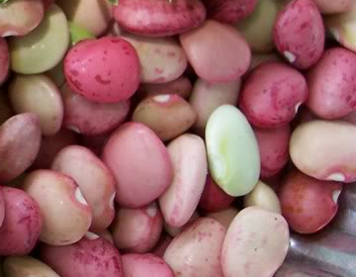
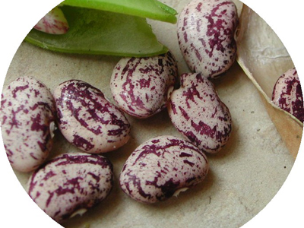
Lima/Butter Beans
‘Christmas Lima’ - does well in hot humid climates.
‘Jackson Wonder’ – drought resistant and does well in hot, dry conditions.
Photo: Slow Food USA
Photo: Southern Exposure Seed Exchange

Slide 25
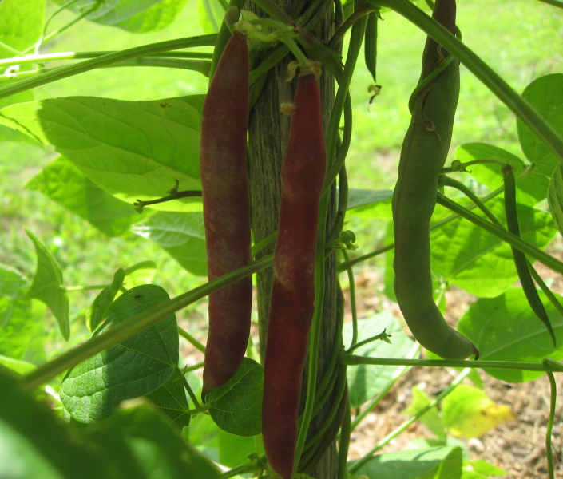
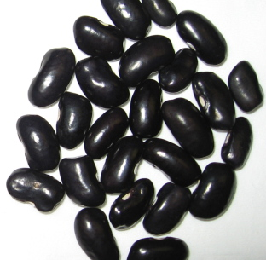
Pole, Snap, and Dry Beans
‘Cherokee Trail of Tears’ – these pole beans were carried by the Cherokee Indians on the ‘Trail of Tears’. Pods are purple in color and seeds are black in color.
Photos: http://elingreso.com

Slide 26
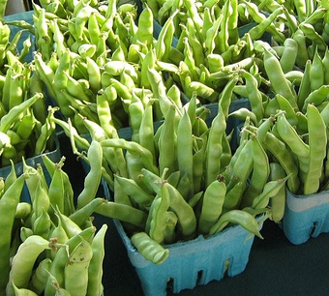
Pole, Snap, and Dry Beans
‘Greasy Cutshort’ pole beans – these beans have shiny leaves, giving a greasy appearance. They are good for use as snap beans.
Photo: www.slotrav.com

Slide 27
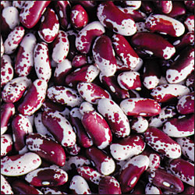
Pole, Snap, and Dry Beans
Jacob’s Cattle’ – Originally from Germany. Pure white beans with deep maroon splashes are produced on 24” plants. Excellent for use in soups and baking.
Photo: Seed Savers Exchange

Slide 28
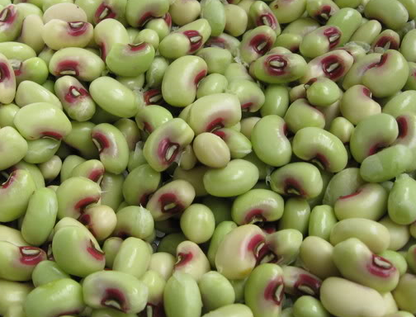
‘Pink-Eye Purple Hull’ Pea
Peas are handled the same way as beans.
Has cream colored seeds with maroon eyes in pods which turn purple at maturity.
Vigorous, heat loving and drought tolerant plants with little vining.
Photo: Garden Web Forum

Slide 29
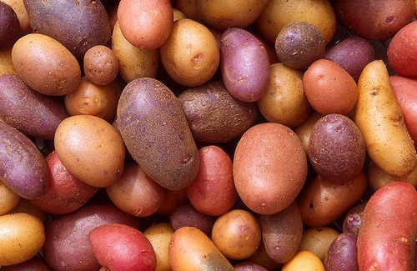
Heirloom Potatoes
Come in different unusual colors, shapes and flavors.
Heirloom potatoes are saved from year to year as tubers.
Easy to maintain and stay true to type.
Photo: CountryFarm-Lifestyles.com

Slide 30
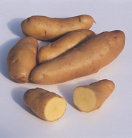
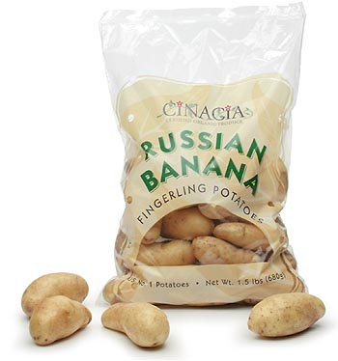
‘Russian Banana’ Potato
Fingerling Potato, thought to have originated from Russia.
Yellow fleshed with waxy texture.
Medium-sized, lavender-flowered plants are resistant to scab and moderately resistant to late blight. Late maturity, good yield, stores well.
Photos: Cinacia.com; Seed Savers Exchange

Slide 31
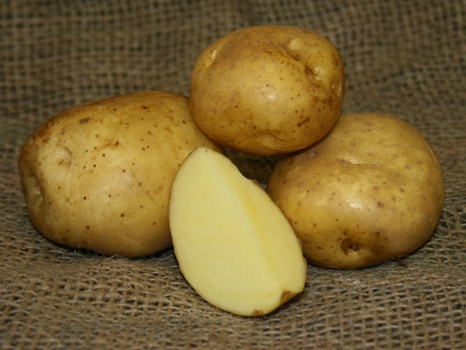
‘Yellow Finns’ Potato
Exceptional buttery sweet flavor.
This is the classic European gourmet potato.
Good for boiling, mashing, frying or baking.
Productive plants, tubers are spread out over larger area than most potatoes.
Excellent keeper, 95-100 days.

Slide 32
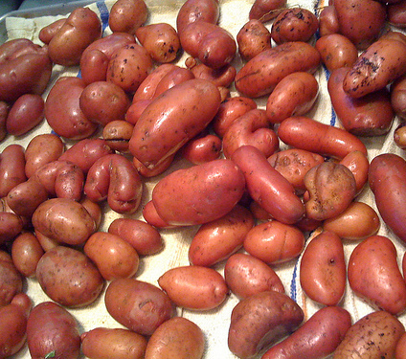
‘Ruby Crescent Fingerling’ Potato
Origin: Andes Mountains Heirloom.
Ruby red skin with deep yellow flesh.
Has small tubers, 2-3” long.
Excellent grilled, sautéed, deep fried, boiled and roasted.
Great in salads.

Slide 33
‘All Blue’ & ‘Russian Blue’ Potato
Origin: Maybe US or the UK in the late 1900s.
Very uniform, oblong to oval shape.
Deep purple skin with netted texture.
Flesh is purple streaked with white and its defining characteristic, a white ring beneath the skin.
Excellent for steaming, mashing, microwaving, brightly colored salads. Keeps color when cooked.
Moderately resistant to late blight, hollow heart, second growth, shatter bruise, PVA, PVM, PVX, PVS.
Susceptible to PVLR, PVY, common scab, bacterial ring rot, black leg, golden nematode Ro1.

Slide 34
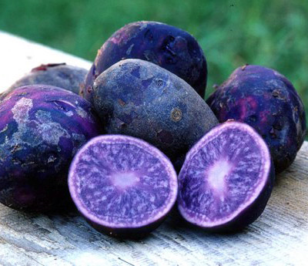
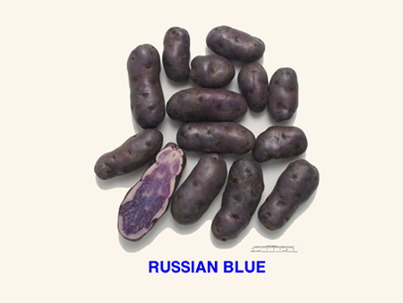
‘All Blue’ ‘Russian Blue’
Photo: California Crop Improvement
Photo: HomeSweetFarm

Slide 35
Squash and Pumpkins
Exception to the open pollinated feature of heirlooms.
Squash and pumpkins readily cross pollinate. Offspring are nothing like the parent plants.
No cross pollination between different species.
Grow only one variety of the same species. Separate by ½ mile radius or hand pollinate to maintain seed purity.
Commonly grown species: banana, buttercup, cushaw and hubbard squash; butternut squash; acorn, crookneck, scallop squash, zucchinis, and most pumpkins.

Slide 36
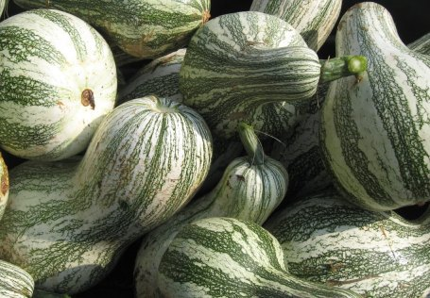
‘Cushaw Green-Striped’ Squash
Up to 20" long , and weigh 10-20 lbs.
The pumpkins have a long curved neck.
The skin is white with green stripes and has thick yellow flesh.
Good for pies and baking.
Drought tolerant and stores well.
Photo: Eden Brothers Seed Company

Slide 37
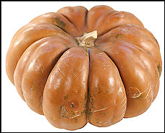
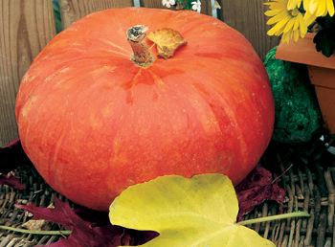
Cinderella Pumpkin
French heirloom pumpkin.
Fruits are deeply ridged, exceptionally flattened, and tan, burnt orange or red in color.
1-2 feet across, and weigh 25-35 lbs.
Photos: Washington Post; Growing Produce.com

Slide 38
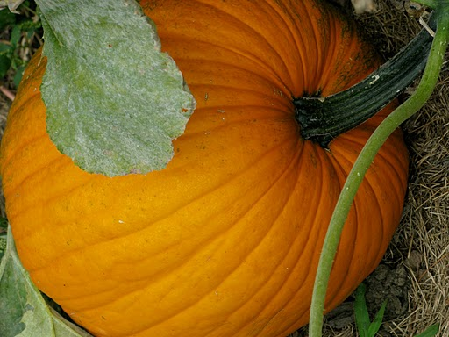
‘Connecticut Field’ Pumpkin
Origin: Grown by the North American Indians prior to European settlement.
Globe shaped deep orange yellow pumpkins.
Flesh is yellow, thick, coarse and stringy.
Good for making canned pumpkin or baking.
Photo: Martha Stewart

Slide 39
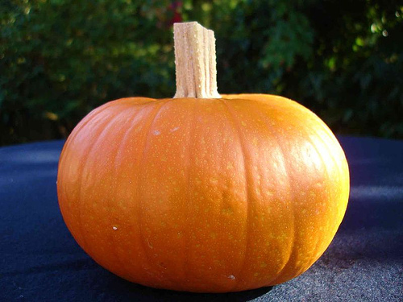
‘Small Sugar’ Pumpkin
An older, smaller variety of the Connecticut Field pumpkin.
Sweet, tasty pumpkins 9-10” in diameter. 8-10 lbs in weight.
Good for making pies.
Deep orange-yellow skin. It is very fine-grained, sweet and sugary, and keeps well.
Prolific bearer.
Photo: Urban Farmer Seeds

Slide 40
Additional Resources
UF-IFAS Small Farms website http://smallfarms.ifas.ufl.edu/
Growing Bell Peppers under shade http://edis.ifas.ufl.edu/hs368
Grafted heirloom tomatoes produced in high tunnels http://www.cefs.ncsu.edu/PDFs/Grafting%20and%20High%20Tunnels%20Heirloom%20fact%20sheet.pdf
All images by Treadwell and Gazula unless otherwise noted.
Copyright 2010 University of Florida

