Slide 1
Phycodnaviridae
Abigail S. Clark
MCB 5505: General Virology
Photo credit: Graham Matthews

Slide 2
Nucleocytoplasmic Large DNA Viruses
Fischer et al. 2010

Slide 3
Algae – Why Should We Care?
Photo credit: Algae Industry Magazine
Photo credit: Disney

Slide 4
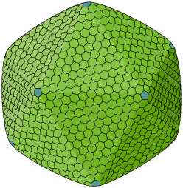
Phycodnaviridae
Six genera:
Prymnesiovirus
Chlorovirus
Coccolithovirus
Raphidovirus
Prasinovirus
Phaeovirus¹
Infects marine and freshwater algae
104 – 118 nm
100 – 170 nm
100 – 220 nm
100 – 220 nm
120 – 150 nm
100 – 220 nm
Highly evolved²
¹ Wilson et al. 2009
² Van Etten & Dunigan, 2012
www.expasy.org

Slide 5
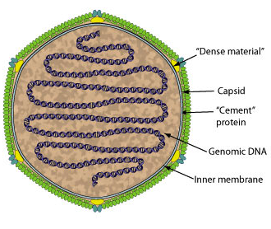
Virus Structure
Members share
Internal lipid membrane
Cement proteins
Dense material
Icosahedral capsid^{1,2}
Capsid composed of
trisymmetrons
pentasymmetrons¹
¹ Wilson et al. 2009
² Van Etten et al. 2002
www.expasy.org

Slide 6
Viral Genome
dsDNA (circular, linear)
160 – 560 kb genomes¹
40 – 50% G+C content
14 homologous genes²
¹ Wilson et al. 2009
² Dunigan et al. 2006
Van Etten et al. 2002

Slide 7
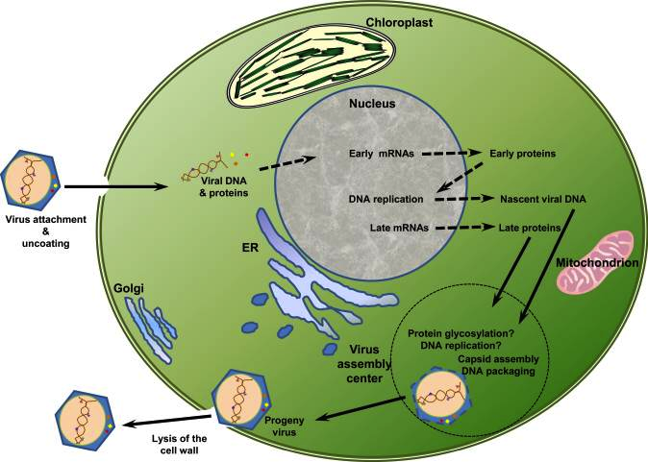
Replication
Van Etten & Dunigan 2012

Slide 8
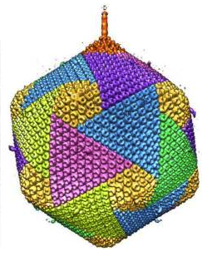
Paramecium bursaria chlorella virus
Genus chlorovirus (lytic)¹
331 kb genome
190 nm
689 open reading frames (ORFs)
Infects ciliate protozoan, P. bursaria²
¹ Wilson et al. 2009
² Dunigan et al. 2012
Van Etten & Dunigan 2012

Slide 9
Ectocarpus fasciculatus virus
Genus phaeovirus (lysogenic)¹
320 kb genome
150 nm²
ORFs unknown, but do know that E. siliculousus virus has 231
Infects gametes of filamentous brown alga, E. fasciculatus¹
¹ Wilson et al. 2009
² Muller et al. 1996

Slide 10
Emiliania huxleyi virus
Genus coccolithovirus (lysogenic)¹
407 kb genome²
170 – 190 nm³
472 ORFs¹
Infects photosynthetic phytoplankton, E. huxleyi
¹ Wilson et al. 2009
² Wilson et al. 2005
³ Wilson et al. 2002

Slide 11
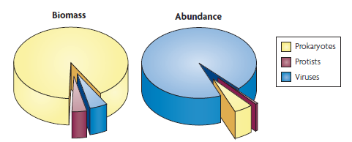
Viruses – The Big Picture
Suttle 2007
Photo credit: PJS Franks

Slide 12
References
Dunigan DD, Cerny, RL, Bauman AT, Roach JC, Lane LC, Agarkova IV, Wulser K, Yanai-Balser GM, Gurnon JR, Vitek JC, Kronschnabel BJ, Jeanniard A, Blanc G, Upton C, Duncan GA, McClung OW, MA F, Van Etten JL. 2012. Paracemium bursaria Chlorella Virus 1 proteome reveals novel architectural and regulatory features of a giant virus. Journal of Virology 86: 8821-8834.
Dunigan DD, Fitzgerald LA, Van Etten JL. 2006. Phycodnaviruses: a peek at genetic diversity. Virus Research 117: 119-132.
Etten JL, Dunigan DD. 2012. Chlorovirus: not your everyday plant virus. Trends in Plant Science 17: 1-8.
Fischer MG, Allen MJ, Wilson WH, Suttle CA. 2010. Giant virus with a remarkable complement of genes infects marine zooplankton.
Muller DG, Sengco M, Wolf S, Brautigam M, Schmid CE, Kapp M, Knippers R. 1996. Comparison of two DNA viruses infecting the marine brown algae Ectocarpus siliculosus and E. fasciculatus. Journal of General Virology 77: 2329-2333.
Suttle CA. 2007. Marine viruses — major players in the global ecosystem. Microbiology 5: 801-812.
Wilson WH, Tarran GA, Schroeder D, Cox M, Oke J, Malin G. 2002. Isolation of viruses responsible for the demise of an Emiliania huxleyi bloom in the English Channel. Journal of Marine Biology Assoc UK 82:369–377
Van Etten JL, Dunigan DD. 2012. Chloroviruses: not your everyday plant virus. Trends in Plant Science 17: 1-15.
Van Etten JL, Graves MV, Muller DG, Boland W, Delaroque N. 2002. Phycodnaviridae – large DNA algal viruses. Archives of Virology 147: 1479-1516.
Wilson WH, Schroeder DC, Allen MJ, Holden MT, Parkhill J, Barrell BG, Churcher C, Hamlin N, Mungall K, Norbertczak H, Quail MA, Price C, Rabbinowitsch E, Walker D, Craigon M, Roy D, Ghazal P. 2005. Complete genome sequence and lytic phase transcription profile of a Coccolithovirus. Science 309: 1090-1092.
Wilson WH, Van Etten JL, Allen MJ. 2009. The Phycodnaviridae: the story of how tiny giants rule the world in James L. Van Etten (ed.) Lesser Known Large dsDNA Viruses Current Topics in Microbiology and Immunology 328: 1-42.
Thank you for your attention!

